Slide 1
MODULE 6
RAPID QUALITATIVE ASSESSMENT TRAINING
Planning a Rapid Qualitative Assessment: Research Questions and Areas of Enquiry

Slide 2
Process for designing and conducting an RQA
Ethical principles for conducting RQAs
01
Establish why an RQA is needed
05
Develop the tool and do the assessment
02
Identify existing data
06
03
Develop research questions
07
Communicate the findings
Ensure findings are used to inform action
04
Set out Terms of Reference
08

Slide 3
Newly published WHO RCCE competency framework to guide skills-building for a competent RCCE workforce. Includes behaviours, activities and tasks for evidence-based RCCE. Rapid assessments is one approach to enhance evidence-based RCCE
Why is evidence needed?

Slide 4
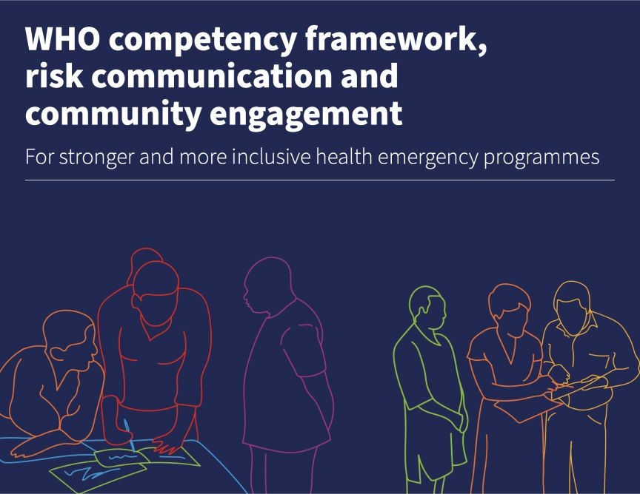
Competency 13. Assesses and uses relevant evidence
13.1 Participates in seeking evidence from social and behavioural sciences ro inform RCCE activity. 13.2 Uses a structured and replicable approach to gather evidence to deliver key RCCE tasks. 13.3 Uses evidence for specific purposes and can describe that purpose. 13.4 Critically ealuates the limitations, quality, relevance and application of evidence. 13.5 Communicates structured, comprehensible and accurate evidence and analytics with appropriate audiences to update and enhance RCCE practice.

Slide 5
Before you start the process, remember to establish:
Key Reasons Why is an RQA needed
01
02
03
04
Understand key social, cultural, political, and economic dynamics
Identify relevant authorities and trusted leaders for message dissemination;
Gather communities’ understanding of the disease and health decision-making processes;
Inform appropriate and effective response efforts.

Slide 6
What existing evidence can you refer to?
RQAs are needed when existing information is insufficient or out of date to address your questions
Possible Sources
Compiling existing evidence
National RCCE plan Health partners / NGOs data Internet searches
Context / situational analyses Socio-behavioural studies Community mapping Report from previous RQA Vulnerability mapping Communications analyses

Slide 7
Phase 1: What are your key questions?
‘Our questions change during the process of research to reflect an increased understanding of the problem’ (Crestwell 2007)
Develop an overarching question Driven by the HOW and the WHY of an issue or topic

Slide 8
Moving from Exploratory to Deep Dive RQA
‘Our questions change during the process of research to reflect an increased understanding of the problem’ (Crestwell 2007)
Phase 1: Exploratory
Phase 2: Deep Dive
How are communities affected by the current drought conditions in Zambia? How are communities and actors responding? Why?

Slide 9
Phase 2: what are your key questions?
01
04
Iterative process to develop specific sub-questions and areas of enquiry within your broader topic.
Drivers of a behavior (why)
02
05
Particular vulnerable population groups
Engagement with other stakeholders (govt, aid/relief, community members)
03
Processes (how)

Slide 10
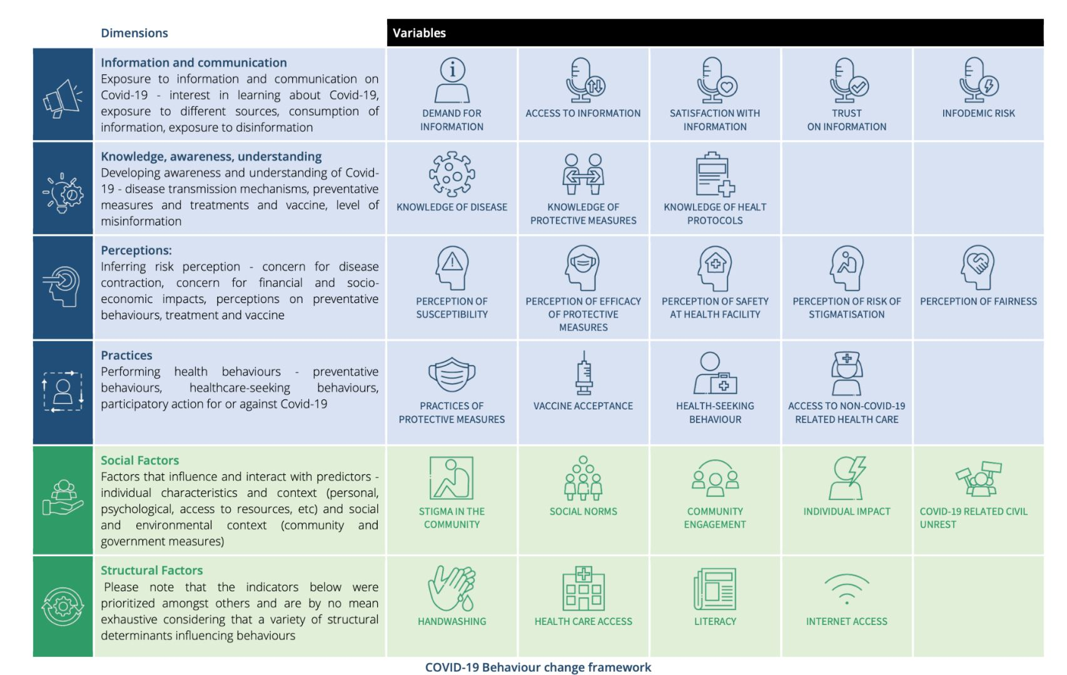

Slide 11
Terms of Reference (ToR) 1 - Structure
01
Background
06
Budget
02
Objectives & questions of enquiry
07
Team composition
03
Scope of work
08
Ethical considerations
04
Deliverables
08
Reporting
05
Timeline

Slide 12
Terms of Reference (ToR) 2 - Scope of work
The Scope of Work covers the key activities:
Stakeholder Engagement:
Data Collection and methods:
Boundaries
Engage with key stakeholders from the RCCE pillar and other pillars
RQA using the following methods e.g. Conduct FGDs with community members; IDIs with key informants such as healthcare providers, local leaders, and affected families. Observation, other participatory methods…
Who / what is included and excluded from the assessment, what locations will it take place in? Which methods in which locations.
Data Analysis:
Reporting:
Method for rapid analysis of the data
What format will the RQA outputs take? Who will the audiences be?

Slide 13
Terms of Reference (ToR) 3 -
The Scope of Work covers the key activities:
Timeline
Budget
Establish timeline, including any key milestones and deadlines
Outline the budget and resources to ensure the project stays on schedule (remember the focus is on rapid)
Team composition
Ethical considerations
Who will do the work? Outline responsibilities of the principle investigator, research assistants, analyst, community ‘gatekeepers’ etc.
Outline the ethical issues and measures to maintain ethical principles

Slide 14
Key Ethical Principles
Ethical principle
Application
Respect for persons
Informed consent
Privacy and Confidentiality
Individuals should be treated as independent individuals, not under the control of others People with diminished ability to act independently require special protection
The person should have the capacity to give consent and should have the power of choice without constraint or coercion – without feeling forced or persuaded The person should have sufficient knowledge and understanding to enable him or her to make the right decision If someone is under the legal age of adulthood, ‘assent’ should be gained from them, and consent should be gained from a caregiver over the legal age of adulthood
Respect confidentiality – participants should be able to choose whether their statements are public and attributable (quoted ‘on record’) or whether their statements are anonymous or not to be quoted (‘off record’). Respect privacy – participants should be able to speak in a comfortable setting free from onlookers; participants should never be forced to reveal information about themselves that the participant does not wish to reveal. Data should be anonymized (where the participant does not request attribution), identifiable information should be removed and data should not be able to be linked to any one person Data should be stored securely
Right to withdraw
This should be possible at any time during the assessment, without consequence This includes the right to ask for the tape-recorder (if one is used) to be switched off

Slide 15
Key Ethical Principles
Ethical principle
Application
Do No Harm
Assessment of risks and benefits
No harm should be done to participants Beyond this, benefit should also be gained from participation in the assessment. Common questions we ask ourselves include: should this be a social or a personal benefit? Who should decide what the benefit should be? The assessment should be necessary and meaningful – it should be unique and it should contribute to the greater good
The nature of risks and benefits should be assessed in a step-by-step way. ‘Risk’ can be defined as: the probability of harm or injury (physical, psychological, social or economic) occurring as a result of participation in research. The potential benefit of the work should outweigh the probability and severity of risks. More information can be found here.
Justice
Selection of participants
Treat people equally, fairly and respect their rights The risks of research should be negligible
In participant selection, wherever you can include a wide range of people; think about gender, ethnicity, and marginalized groups Think about specific groups who are particularly vulnerable to the impacts of the crisis you’re supporting and make sure you include them

Slide 16
Challenges to Applying Ethical Principles
Do No Harm When have you faced this?
Informed consent When have you faced this?
Confidentiality and privacy When have you faced this?

Slide 17
Ethics Approvals
01
03
Ethics review board approval process is not required for RQAs as data needs to be used in as close to real-time as possible
Rapid Qualitative Assessments are intended for informing operational response decision making
02
04
Data is not intended to be published in academic publications
BUT – ethical principles must still be maintained

Slide 18
Ethics Approvals with Communities
How might ethical principles be maintained with communities involved in RQAs?

Slide 19
Consider your current work with communities. Which ethical principles guide your work?
Key Ethical Principles

Slide 20
Ethical Approvals and Consent
01
04
Acknowledge the leadership of the community
Acknowledge the members of the community
02
05
Ask their permission to enter the community
Seek permission to conduct the rapid qualitative assessments
03
06
Explain the rapid qualitative assessments that you are planning to carry out and the potential benefits and risks
Consider who you obtain permission from - think about power dynamics in the community: who has the authority to give permission, who is excluded from such decision making? Does permission given from leadership extend to all members?

Slide 21
Ethical Approvals and Consent
07
08
Explain informed consent and data privacy
Consider establishing formal mechanisms such as community advisory boards to work with throughout the phases of the RQAs: data collection, analysis of findings, development and implementation of recommendations
09
Ensure time and budget for discussing the findings with communities and supporting locally-led action

Slide 22
The ethical principles that guide operational social science assessments include respect for persons, doing no harm, and justice. Including: Getting voluntary informed consent from participants Allowing the right to withdraw at any time Maintaining privacy Weighing risks and benefits of participating Selection of participants Formal ethical approval from an institutional ethics review board is not required for RQAs but ensuring ethical principles are respected is still critical Community leaders and members participating in RQAs should be involved at each stage of the process: data collection, analysis of findings, development and implementation of recommendations
Summary

Slide 23
Debrief and Reflections from Day 1
01
What did you learn yesterday?
02
What was something new or interesting?
03
What questions do you have?

Slide 24
Identification of Gaps
01
For Cholera or for Drought
02
What do we need in order to act?
What don’t we know?
In small groups, after we hear the Drought RQA findings, we will develop the priority gaps. Use resource people or key documents

Slide 25
Designing a topic guide

Slide 26
Methods for developing the tool (1)
Resources for developing RQA Tools:
01
Identify key areas of inquiry, e.g.:
Factors affecting healthcare seeking behavior​ Beliefs/perceptions/ practices around an outbreak or a disease​ Experiences with the disease, perceived social impacts
Bank of Risk Communication and Community Engagement Assessments, Surveys, and Feedback Tools SSHAP Rapid Anthropological Assessments in the Field Collective Service Cholera Questions Bank
02
Identify existing tools/resources

Slide 27
What is your AOE? What is your target population? What are your key questions?
Develop your data collection tool (guides) on the basis of your area of enquiry (AOE) and target population.
01
02
Key Informant Interview (KII) Guide
Focus Group Discussion (FGD) Guide

Slide 28
What is your AOE? What is your target population? What are your key questions?
Area of enquiry (AOE)…? Topic sentence…?

Slide 29
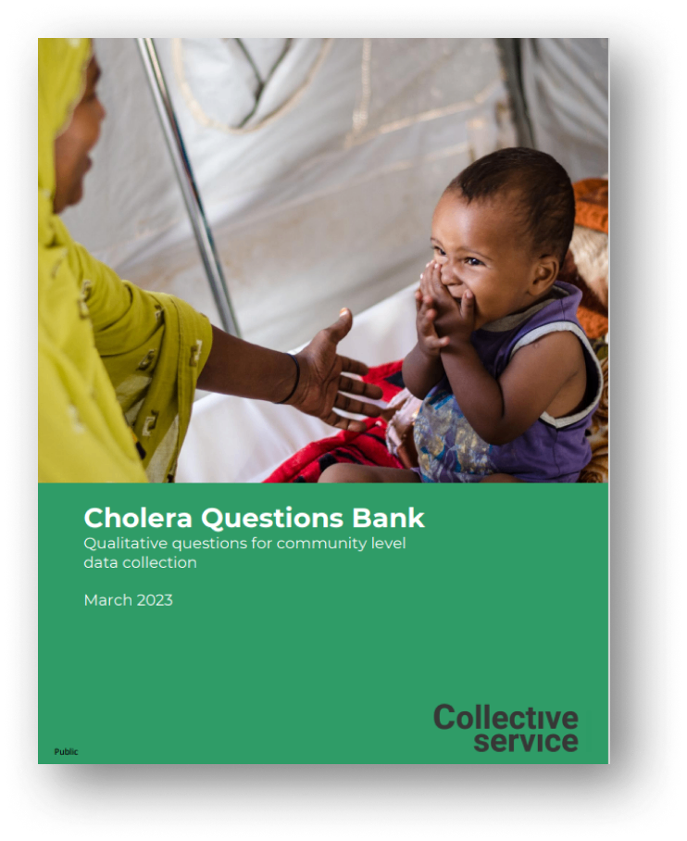
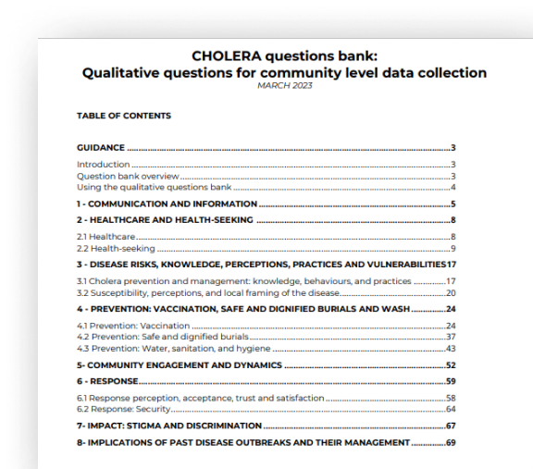
Methods for developing the tool
Develop the data collection tool
Whenever possible, keep questions open-ended (not yes/no not a survey)​ Identify and include probes and alternate wording for questions that may be challenging to interpret

Slide 30
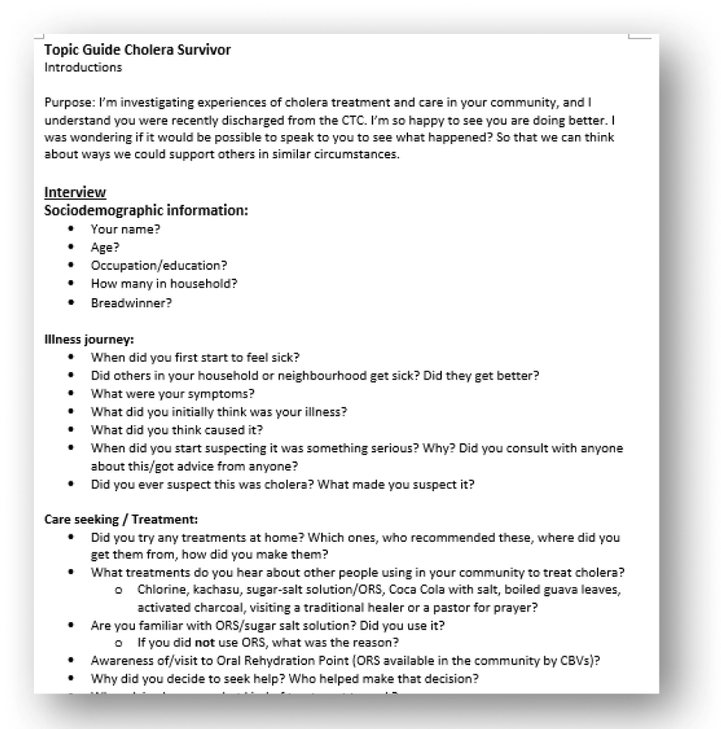
Methods for developing the tool
Develop the data collection tool (cont’d) Start with sociodemographic questions (less emotionally charged, build rapport) Group questions by thematic area Order questions chronologically when possible Review and revise tools with team Pilot test and adapt as needed

Slide 31
Using findings
Communication of findings should promote:
Consider:
inclusive health emergency management​ meaningful engagement​ community centred practice
Who are your key audiences / stakeholders? What are their:​ Interests and priorities​ Opinions​ (Political) motivations and goals​ Blockages for action ​ Language​ What format works best for your audience - use different formats for different audiences.​ Use different events and existing channels to have maximum impact

Slide 32
Communicate findings
Key findings should be linked to concrete recommendations and to its potential impact
Example recommendation:
Example recommendation:​ ‘RCCE actors should provide guidance on how people can access vaccinations. Communications should address concerns about vaccine safety and side effects. Emerging types of misinformation around vaccines should be tracked, and approaches developed to dispel hesitancy. These measures could help increase uptake of vaccination.’​ It helps the intended users understand:​ ‘This finding is crucial to the outcome of the vaccination programme’​ ‘There is something actionable we can do about this’​ ‘That action will have impact’

Slide 33
Using findings
Recommendations for impact
Make the recommendations fit the context and resources available ​ Separate short-term recommendations that are easily actionable from the recommendations that may take more time and resources to achieve​ Clearly target each recommendation to a specific user – e.g. which recommendations are for fellow community engagement and/or communications actors, which are for government actors, which are for communities and so on…​ Where ever possible, develop these recommendations jointly with affected communities, or get their input and feedback.

