Slide 1
MODULE 1
RAPID QUALITATIVE ASSESSMENT TRAINING
Welcome & Introduction

Slide 2
Learning Objectives
01
03
Introduce yourself and get to know participants and facilitators
Formulate and apply ground rules for fostering a safe and respectful learning environment
02
04
Discuss training objectives and how these align to your own expectations and learning goals
Refresh understanding of what Risk Communication and Community Engagement is and why it is important

Slide 3
Content
01
02
03
04
Welcome
Introductions
Opening remarks
Icebreaker
05
06
07
Expectations
Objectives
Ground rulers

Slide 4
Objectives
Overall Objective
To contribute to more effective and community centred responses by strengthening systems for utilisation of community data in emergency response by MOH, government and partners.
Training Objective
To build implementing partner capacity to undertake rapid qualitative assessments to better understand community perspectives & needs. To advocate for prioritisation of collection and utilisation of community data across all pillars of emergency response. To pilot a training package which can be used to strengthen community data use for other countries in East and Southern Africa

Slide 5
Training Roadmap
Day
Day
Day
Day
Day
1
2
3
4
5
Intro to RCCE Intro to RQAs Ethics Qual vs Quant data Participatory methods
Topic guides Screening criteria RAP sheets
Testing tools Notetaking Roleplays
Piloting tools, field work Revision of tools
Analysis and results Developing recommendations Advocacy Field work plan

Slide 6
Icebreaker
Who is in the room? Introduce yourself – name, role, where you work and what experience you have in qualitative research and RCCE Why did you want to come to this training? What are your expectations for this training?

Slide 7
Standard Group Rules
What is Sexual Harassment any unwelcome sexual advance or unwanted verbal or physical conduct of a sexual nature between Personnel. Sexual Exploitation and Abuse, which refers to exploitation or abuse of Affected Persons. What does zero tolerance mean? If there is an incident of sexual harassment the perpetrator will be excluded from the training and the surge roster The incident will be reported to their line manager What to do if it happens this week? Report it to UNICEF or any facilitator you feel comfortable speaking to

Slide 8
Setting Ground Rules
In your groups, discuss the following: What values are you bringing to the workshop? How do we demonstrate or uphold these values? What should the group ground rules be for this workshop?

Slide 9
Information about the venue Restrooms Emergency rallying point Breakfast, lunch, snacks, dinner WiFi – open access / code Changing money Taking photos – consent The outside world
General Info

Slide 10
MODULE 2
RAPID QUALITATIVE ASSESSMENT TRAINING
Introduction to Risk Communication and Community Engagement

Slide 11
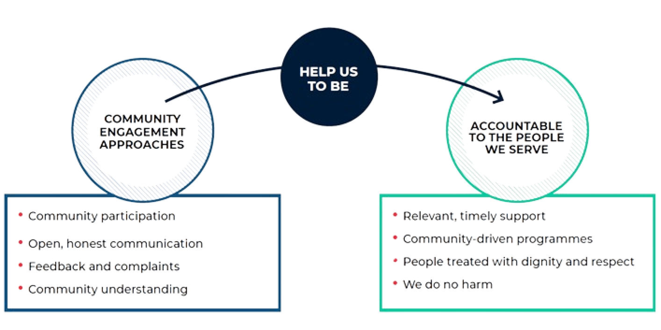
What is Risk Communication and Community Engagement?
Discuss

Slide 12
Different name, same aims
Accountability to Affected People (AAP) Community Engagement and Accountability (CEA) Communication with Communities (CwC) Risk Communication and Community Engagement Social and Behaviour Change Communication
Using meaningful community participation, open and honest communication, and mechanisms to listen to and act on feedback to improve accountability to the people we serve
As above, with a focus on using communication and participatory approaches to encourage positive and healthy behaviours in health programmes or epidemics

Slide 13
Why is Risk Communication and Community Engagement important in epidemics?
Discuss
Epidemics start and end in communities
Behaviour change is complex
The community knows best
Community members must be active partners in the response
One-way messaging and awareness raising is not enough
Communities know better than anyone how to encourage safer, healthier practices and what could prevent them
Trust is a key ingredient
To build trust, we need to listen and act
If communities don’t trust us, they will not listen, contribute, or implement the actions needed to control an epidemic, or may react with hostility and violence
Feedback is crucial to understand community perceptions and adapt our response to stay relevant and effective

Slide 14
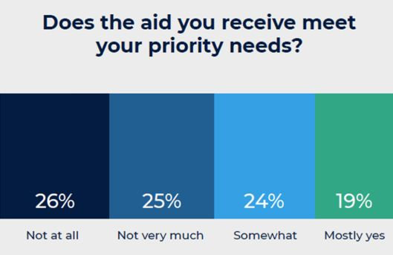
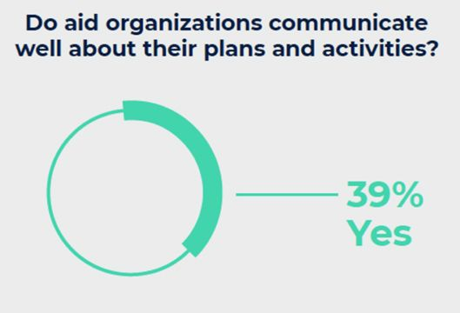
The gap between rhetoric and reality
"There's not enough time to do community engagement – people are dying!"
"We can't change the response plan now as it's already been approved by the donors"
"We already know the community well enough from other outbreaks"
"We are the health experts so we know what is best"

Slide 15
RCCE as an integrated approach
Surveillance
Case Management
Community involvement in contact tracing Rapid community insights of transmission patterns & hotspots Effective community-based surveillance
Ensure participation in burials, respecting local customs Generate insights on patient care, perspectives of caregivers
Infection Prevention & Control
Points of Entry
Insights on local transmission risks & locally-led solutions Engagement with local healers, birth attendants, caregivers Community-centred vaccination campaigns
Support effective 2-way communication channels in languages spoken by those crossing at border points Mapping of local community networks to engage on safe travel and migration

Slide 16
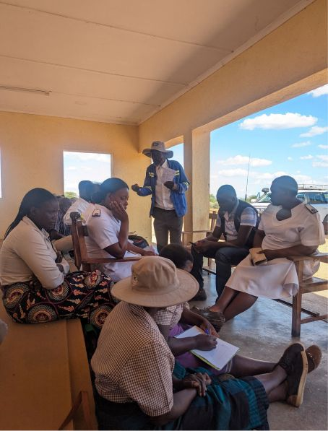
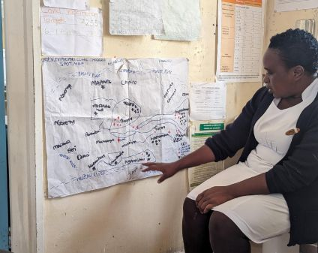
RQAs in action!
Rapid qualitative assessments for cholera in Zimbabwe Series of rapid qualitative data collection exercises incl. observation, FGDs, and KIIs in cholera hotspots Data collection tools adapted to focus on key enquiries each round, based on the cholera questions bank Building on work initiated in Malawi, refined in Zimbabwe, now being deployed in Zambia Data collected and analysed by multiple partners Findings disseminated through user-friendly information products and discussed with all pillar leads
A nurse presents a cholera hotspot map
A FGD with community leaders

Slide 17
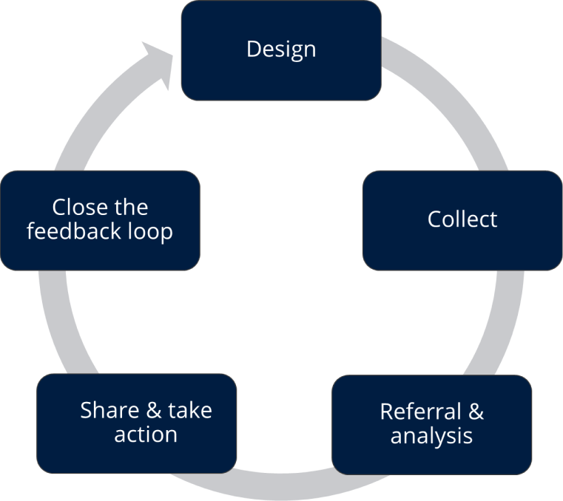
What is community feedback?
Insights generated by community members which can be negative or positive: Insights generated by community members which can be negative or positive: Questions Suggestions Concerns Perceptions or beliefs Praise or statements of thanks Received through: House-to-house visits Hotlines Helpdesks Community meetings ...and many more!

Slide 18
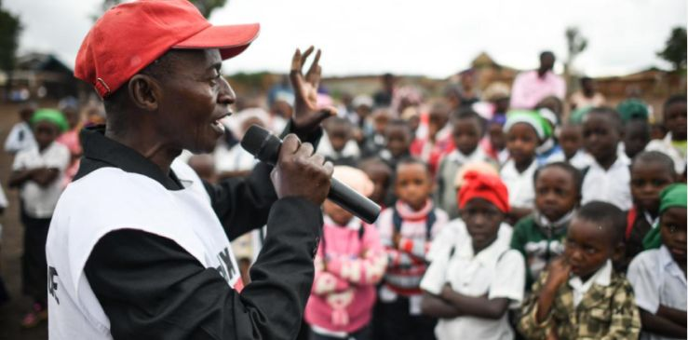
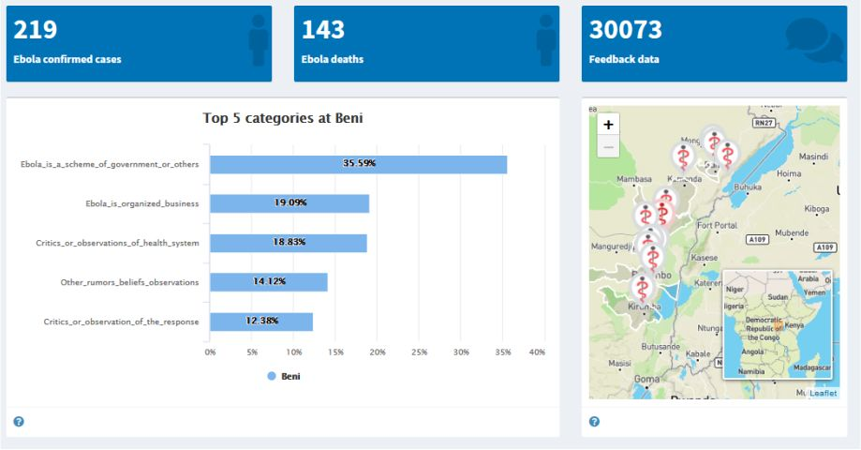
An example from DRC Red Cross
Feedback dashboard in DRC
Bunia, DR Congo: DRC Red Cross volunteers regularly engage with students, providing critical information about Ebola and how to prevent other major diseases. It also gives opportunities for students to ask questions and provide feedback to volunteers who share this in the community feedback system set up with IFRC and CDC

Slide 19
Group exercise
Steps to setup a feedback mechanism Each group will receive 13 cards with the steps for setting up and running a feedback mechanism Take 10 mins to discuss what order they should go in

Slide 20
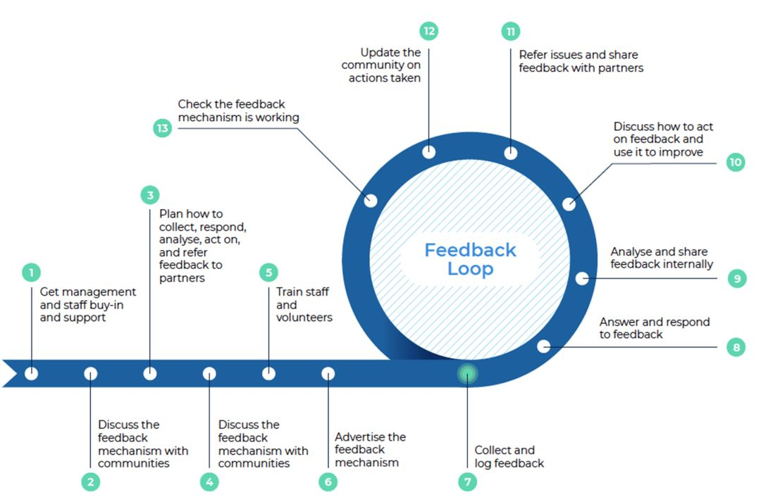
Step to setup and run a feedback mechanism
Did you agree?

Slide 21
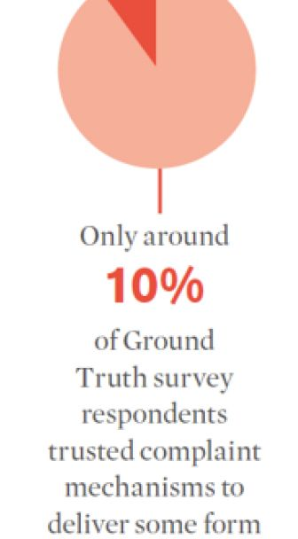
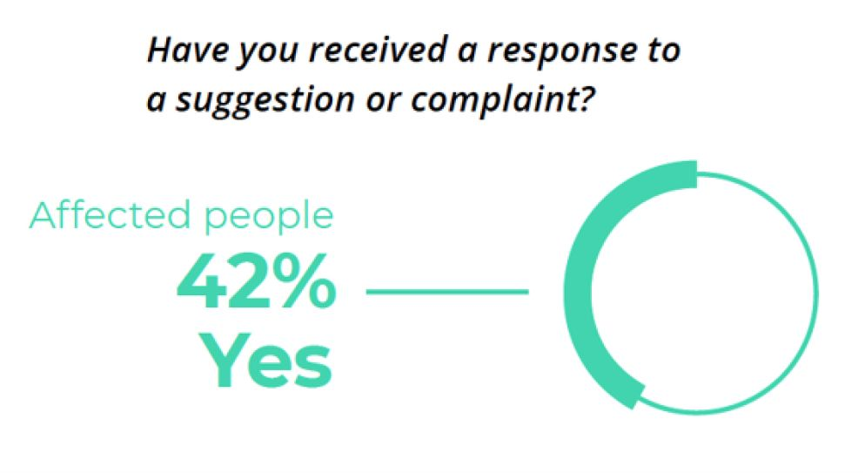
What is the biggest challenge in collecting rapid social insights?
…Acting on the data!

Slide 22
Case study: Zambia cholera outbreak
What would you do to respond?
Context
Other feedback from community:
Increasing cases, especially in Lusaka hotspots with high case fatality rates linked to late health facility attendance Community feedback from families showed overall good levels of knowledge Price of chlorine almost doubled during the outbreak Most at-risk of cholera are least likely to afford to protect themselves
People using kachasu (homemade spirit) to prevent and treat cholera Some had taken self/loved ones to health facilities: given antibiotics, sent home Transport was challenging: roads impassable, local taxis wouldn’t collect people, $$ Belief that the central CTC delivered very poor care and you would die if you went

Slide 23
Tools and resources on RCCE
RCCE Collective Service website Cholera question bank RCCE coordination in public health emergencies guidance IFRC community feedback toolkit The team: Rachel James, IFRC/Collective Service, (rachel.james@ifrc.org) Nadine Beckmann, UK-PHRST, (nadine.beckmann@lshtm.ac.uk) Ginger Johnson, SSHAP, (johnson.ginger@gmail.com) Olivia Tulloch, WHO/Collective Service, (tullocho@who.int) Sophie Everest UK-PHRST, (sophie.everest@ukhsa.gov.uk) Christina Craig, CDC, (prl5@cdc.gov)

Slide 24
Questions?

