Slide 2
LEARNING OUTCOMES
Become familiar with different products and channels for communicating social science evidence
Know how to understand and map different stakeholders, including intended users of the research findings and recommendations
Be able to create an effective communications plan

Slide 3
Key questions in social science research
DATA TO ACTION:
Key questions in social science research
What information is needed?
Who needs this information?
Does this information already exist? Is there a related needs assessment or study?
Who can collect this information?
What methodology and tools should be used to collect and analyse this information?
How to ensure that this information goes back to communities? To inform community-level actions and decision-making of the broader response?
How to ensure that the information is used to make operational and/or strategic decisions?
How to track the information used to ensure that it effectively contributes to operational and strategic priorities?

Slide 4
Communicating research outputs
Why is the communication of research such an important step to consider?

Slide 5
Communicating research outputs
What might be some of the challenges to communicating social science outputs in an emergency setting?
What have you learned or observed from your own work?

Slide 6
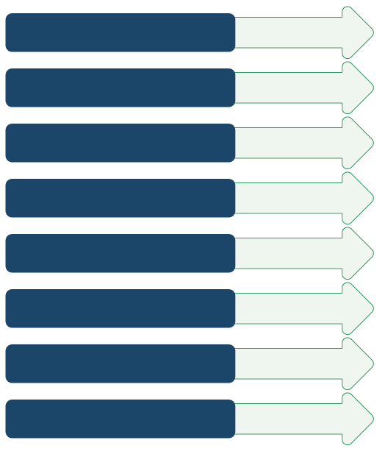
Products – what you produce
Policy brief
Academic journal article
Online blog/article
Manual/guideline document
Research/evaluation report
PowerPoint slides
Short video/animation
Infographics

Slide 7
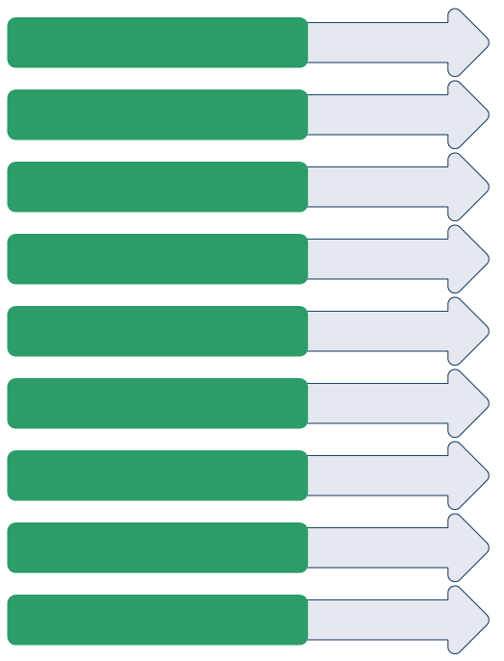
Channels – how you distribute your products
Working group/cluster/ network meeting
Webinar
Conference
Public online resource collection
Social media
Policy review/policy development meeting
Informal meeting
Training sessions
Meeting/briefing with key stakeholders

Slide 8
Making your communications plan
Set objective that are:
Specific, Measurable, Achievable, Relevant and Timely
Example:
Make this objective SMART.
I want to reduce cholera transmission in my community.
I will increase handwashing practices in X community by 10% (based on baseline data from my report on hand-washing practices) by running 3 radio campaigns on World Health Day (in 2 weeks’ time).

Slide 9
Identify users of research
International agencies/multilateral organizations
Working group/cluster members
Governments/ministries
Communities affected by a crisis
Local civil society organizations (CSOs)
Funders/donors
Traditional media
Social media
Academia
Any others?

Slide 10
Who are the most important stakeholders?

Slide 11
Know your audience
Organizational interests and priorities
Personality traits
Interests and priorities
Values
Opinions
Political motivations and goals
Blockages for action
Language

Slide 12
Know your audience
Organizational / Personal

Slide 13
Stakeholder Template
Key info/bio Why have you chosen this stakeholder? | Interests and priorities
Information needs | Motivations
How do they usually get their information? | Appropriate products and channels
 | Key opportunities to engage

Slide 14
A message that turns outputs into action
Show how this (whatever you have to communicate/your message) is vital to achieving priority goals
These findings are crucial to the outcome of your activities
Fit what you have to communicate/your message into the wider context of the response
This will ultimately help curtail the spread of this disease
Keep what you have to communicate/your message solution-focused and actionable
There is something actionable we can do about this
This action will have impact
“
”
“
”
“
”
“
”

Slide 15
Summary
When the findings and recommendations of social science research are effectively communicated to key actors in the response, this can significantly improve the way humanitarian response is designed and delivered.
When making a communication plan it is important that the following steps are followed:
Set SMART objectives
Identify priority users of the research findings
Get to know your audience – in terms of information needs, interests and priorities, and underlying motivations
Identify appropriate products, channels and opportunities to engage your audience
Construct a message that will help turn research findings into action

