Slide 2
LEARNING OUTCOMES
Become familiar with the basic language challenges in social science research
Understand the risks of conducting social science research which is not language-sensitive
Understand how social sciences can support community engagement and/or communications activities through language-sensitive research

Slide 3
Key questions in social science research
DATA TO ACTION:
Key questions in social science research
What information is needed?
Who needs this information?
Does this information already exist? Is there a related needs assessment or study?
Who can collect this information?
What methodology and tools should be used to collect and analyse this information?
How to ensure that this information goes back to communities? To inform community-level actions and decision-making of the broader response?
How to ensure that the information is used to make operational and/or strategic decisions?
How to track the information used to ensure that it effectively contributes to operational and strategic priorities?

Slide 4

Context analysis
What kinds of contextual information do you/would you find useful
as a responder to a crisis?

Slide 5
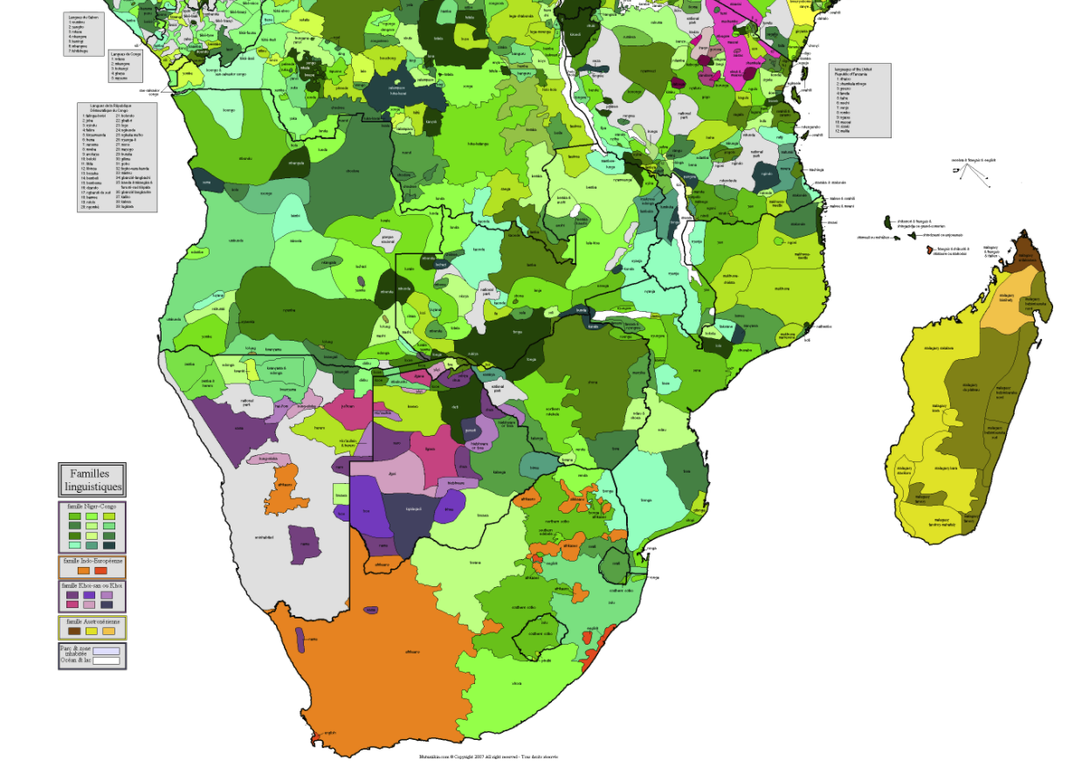
Language maps

Slide 6
Using the correct language
Ask community-based organizations or local research focal persons for guidance
Ask all research participants what their preferred languages are
Understand which groups speak a language which is often overlooked or not incorporated, and dedicate specific data collection activities with those groups
Ask people living with disabilities about their language preferences, e.g. sign language
Do not assume that people will prefer to read the same language they prefer to speak
Prepare material in a variety of languages if necessary

Slide 7
Why does language matter in research?
What are examples of words which are often misunderstood from your areas of expertise, e.g. to ‘engage’ communities, to ‘adopt preventive behaviours’.

Slide 8
Why does language matter in research?
Clarifying terms at the start of your discussions will mean that:
You collect the information on the topics you intend to
You don’t cause offence or embarrassment
You may understand crucial differences in understanding which enrich your findings and inform approaches to your work

Slide 9
Group exercise
Addressing marginalization through being sensitive to language in research: How will you know you have done this?

Slide 10

CASE STUDY
Why is language important in public health campaigns? See TWB example from 2018 Ebola outbreak in Goma, DRC.

Slide 11
SUMMARY
Collect data on the languages spoken and language preferences of different groups
Collect data on preferred communication channels and formats of different groups
Understand the meaning of terms specific to the response, e.g. ‘vaccine’ – testing terminology and comprehension by different groups
Understand from communities which terms related to disease and treatment are widely understood and accepted
Conduct a language sensitivity evaluation that aims at understanding ethnic / conflict tensions that are affecting communication or communicators

