Slide 1
Notes:
FACILITATOR NOTES

Slide 2
Process for designing and conducting an RQA
Establish why an RQA is needed
Identify existing data
Develop research questions
Set out Terms of Reference
Ethical principles for conducting RQAs
Develop the tool and do the assessment
Communicate the findings
Ensure findings are used to inform action
Notes:
This session is about the process of doing a rapid qualitative assessment. You will see here the main steps in the process. It may look like the most important part is step 6, when you design your tools and do the assessment. Actually they are all vital steps, if any are not done sufficiently well then it puts the success of the other steps at risk.

Slide 3
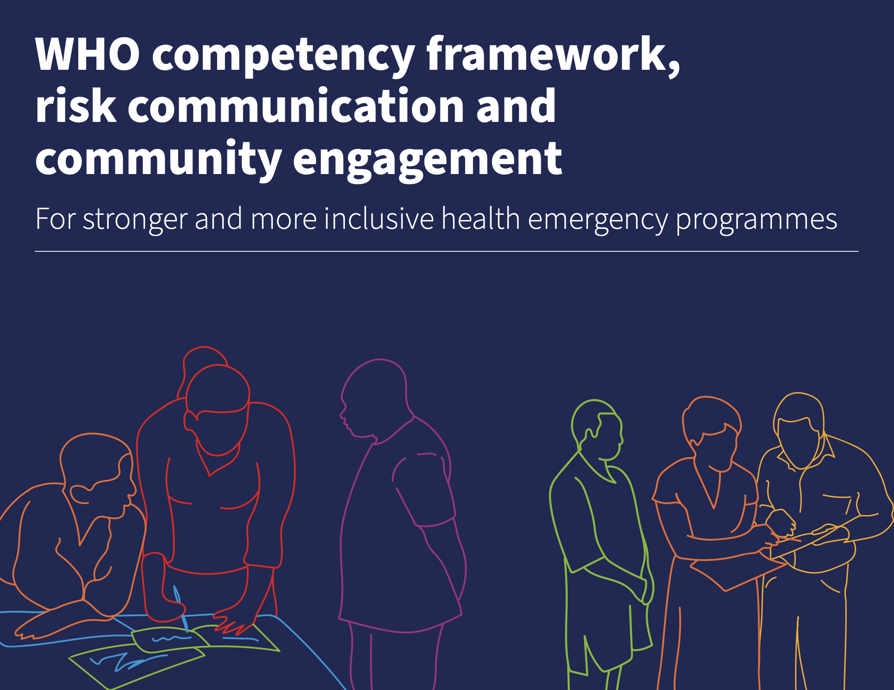
Why is evidence needed?
Newly published WHO RCCE competency framework to guide skills-building for a competent RCCE workforce.
Includes behaviours, activities and tasks for evidence-based RCCE.
Rapid assessments is one approach to enhance evidence-based RCCE
Notes:
RCCE Activities need to be driven by evidence! IF we don’t have evidence, we need to collect it.
FACILITATOR NOTES
Before we consider why an RQA is needed, it is important to remind ourselves why evidence is needed at all.
RCCE teams play a critical role in transforming evidence into messages, materials and interventions that influence behaviours and can save lives. A structured and accessible approach to using evidence fosters trust, inclusion and shared ownership of strategies and actions.
Making sure that RCCE practice is based on evidence ensures that technical work and solutions are grounded on a solid and rigorous foundation.
Generating, analysing and using data and evidence is therefore fundamental to effective emergency management.
The recently published Competency Framework for RCCE published by WHO sets out the behaviours (shown on this slide) as well as key activities and tasks for a rigorous process in collecting and using evidence for public health emergencies. These are the behavioural competencies that RCCE teams should demonstrate when it comes to evidence.
Talk through competency 13. Ask the group - who feels they already have some of these competencies? Ask someone to share an experience when they have demonstrated one or any of these.

Slide 4
Before you start the process, remember to establish:
"Why is an RQA needed?”
Key reasons:
Understand key social, cultural, political, and economic dynamics
Identify relevant authorities and trusted leaders for message dissemination;
Gather communities’ understanding of the disease and health decision-making processes;
Inform appropriate and effective response efforts.
Notes:
FACILITATOR NOTES: Collection of new data should be undertaken where existing information sources are insufficient to the reasons we looked at just now:

Slide 5
What existing evidence can you refer to?
RQAs are needed when existing information is insufficient or out of date to address your questions
Possible sources:
Notes:
FACILITATOR NOTES
The sorts of evidence you will search for depends on what the reason is for doing the assessment.
In the urgent context of a new disease outbreak evidence and data are needed to inform the response FAST.
This is the reason why it is important first to see what information already exists, and what may be relevant to inform immediate response actions.
If, in the case of Cholera for example, there have been outbreaks in the recent past there should be some existing information on socio-behavioual factors, e.g. on levels of knowledge about transmission, perception of risk
Other evidence may be out of date, or from areas with different contextual features.
In some contexts the national RCCE plan may either have mapped the 4Ws - who is doing what, where, why? And this will point you to possible sources of evidence. It may also refer to existing evidence.
Ask the group - of the list on the right, which ones do you think it is important are very up to date, and which ones can be older? Ask them to explain why they have given their answers.

Slide 6
What existing evidence can you refer to?
RQAs are needed when existing information is insufficient or out of date to address your questions
Possible sources:
National RCCE plan
Health partners / NGOs data
Internet searches
Compile existing evidence e.g.
Notes:
FACILITATOR NOTES
The sorts of evidence you will search for depends on what the reason is for doing the assessment.
In the urgent context of a new disease outbreak evidence and data are needed to inform the response FAST.
This is the reason why it is important first to see what information already exists, and what may be relevant to inform immediate response actions.
If, in the case of Cholera for example, there have been outbreaks in the recent past there should be some existing information on socio-behavioual factors, e.g. on levels of knowledge about transmission, perception of risk
Other evidence may be out of date, or from areas with different contextual features.
In some contexts the national RCCE plan may either have mapped the 4Ws - who is doing what, where, why? And this will point you to possible sources of evidence. It may also refer to existing evidence.
Ask the group - of the list on the right, which ones do you think it is important are very up to date, and which ones can be older? Ask them to explain why they have given their answers.

Slide 7
What existing evidence can you refer to?
RQAs are needed when existing information is insufficient or out of date to address your questions
Possible sources:
National RCCE plan
Health partners / NGOs data
Internet searches
Compile existing evidence e.g.
Context / situational analyses
Socio-behavioural studies
Community mapping
Report from previous RQA
Vulnerability mapping
Communications analyses
Notes:
FACILITATOR NOTES
The sorts of evidence you will search for depends on what the reason is for doing the assessment.
In the urgent context of a new disease outbreak evidence and data are needed to inform the response FAST.
This is the reason why it is important first to see what information already exists, and what may be relevant to inform immediate response actions.
If, in the case of Cholera for example, there have been outbreaks in the recent past there should be some existing information on socio-behavioual factors, e.g. on levels of knowledge about transmission, perception of risk
Other evidence may be out of date, or from areas with different contextual features.
In some contexts the national RCCE plan may either have mapped the 4Ws - who is doing what, where, why? And this will point you to possible sources of evidence. It may also refer to existing evidence.
Ask the group - of the list on the right, which ones do you think it is important are very up to date, and which ones can be older? Ask them to explain why they have given their answers.

Slide 8
Phase 1: What are your key questions?
‘Our questions change during the process of research to reflect an increased understanding of the problem’ (Crestwell 2007)
Develop an overarching question
Driven by the HOW and the WHY of an issue or topic
Notes:
FACILITATOR NOTES
The sorts of evidence you will search for depends on what the reason is for doing the assessment.
In the urgent context of a new disease outbreak evidence and data are needed to inform the response FAST.
This is the reason why it is important first to see what information already exists, and what may be relevant to inform immediate response actions.
If, in the case of Cholera for example, there have been outbreaks in the recent past there should be some existing information on socio-behavioual factors, e.g. on levels of knowledge about transmission, perception of risk
Other evidence may be out of date, or from areas with different contextual features.
In some contexts the national RCCE plan may either have mapped the 4Ws - who is doing what, where, why? And this will point you to possible sources of evidence. It may also refer to existing evidence.
Ask the group - of the list on the right, which ones do you think it is important are very up to date, and which ones can be older? Ask them to explain why they have given their answers.

Slide 9
Moving from Exploratory to Deep Dive RQA:
‘Our questions change during the process of research to reflect an increased understanding of the problem’ (Crestwell 2007)
Phase 1: Exploratory
How are communities affected by the current drought conditions in Zambia?
How are communities and actors responding? Why?
Phase 2: Deep Dive
Notes:
FACILITATOR NOTES
The sorts of evidence you will search for depends on what the reason is for doing the assessment.
In the urgent context of a new disease outbreak evidence and data are needed to inform the response FAST.
This is the reason why it is important first to see what information already exists, and what may be relevant to inform immediate response actions.
If, in the case of Cholera for example, there have been outbreaks in the recent past there should be some existing information on socio-behavioual factors, e.g. on levels of knowledge about transmission, perception of risk
Other evidence may be out of date, or from areas with different contextual features.
In some contexts the national RCCE plan may either have mapped the 4Ws - who is doing what, where, why? And this will point you to possible sources of evidence. It may also refer to existing evidence.
Ask the group - of the list on the right, which ones do you think it is important are very up to date, and which ones can be older? Ask them to explain why they have given their answers.

Slide 10
Moving from Exploratory to Deep Dive RQA:
‘Our questions change during the process of research to reflect an increased understanding of the problem’ (Crestwell 2007)
Phase 1: Exploratory
How are communities affected by the current drought conditions in Zambia?
How are communities and actors responding? Why?
Phase 2: Deep Dive
Notes:
FACILITATOR NOTES
The sorts of evidence you will search for depends on what the reason is for doing the assessment.
In the urgent context of a new disease outbreak evidence and data are needed to inform the response FAST.
This is the reason why it is important first to see what information already exists, and what may be relevant to inform immediate response actions.
If, in the case of Cholera for example, there have been outbreaks in the recent past there should be some existing information on socio-behavioual factors, e.g. on levels of knowledge about transmission, perception of risk
Other evidence may be out of date, or from areas with different contextual features.
In some contexts the national RCCE plan may either have mapped the 4Ws - who is doing what, where, why? And this will point you to possible sources of evidence. It may also refer to existing evidence.
Ask the group - of the list on the right, which ones do you think it is important are very up to date, and which ones can be older? Ask them to explain why they have given their answers.

Slide 11
Phase 2: what are your key questions?
Iterative process to develop specific sub-questions and areas of enquiry within your broader topic.
Particular vulnerable population groups
Processes (how)
Drivers of a behavior (why)
Engagement with other stakeholders (govt, aid/relief, community members)
Notes:
FACILITATOR NOTES
The sorts of evidence you will search for depends on what the reason is for doing the assessment.
In the urgent context of a new disease outbreak evidence and data are needed to inform the response FAST.
This is the reason why it is important first to see what information already exists, and what may be relevant to inform immediate response actions.
If, in the case of Cholera for example, there have been outbreaks in the recent past there should be some existing information on socio-behavioual factors, e.g. on levels of knowledge about transmission, perception of risk
Other evidence may be out of date, or from areas with different contextual features.
In some contexts the national RCCE plan may either have mapped the 4Ws - who is doing what, where, why? And this will point you to possible sources of evidence. It may also refer to existing evidence.
Ask the group - of the list on the right, which ones do you think it is important are very up to date, and which ones can be older? Ask them to explain why they have given their answers.

Slide 12
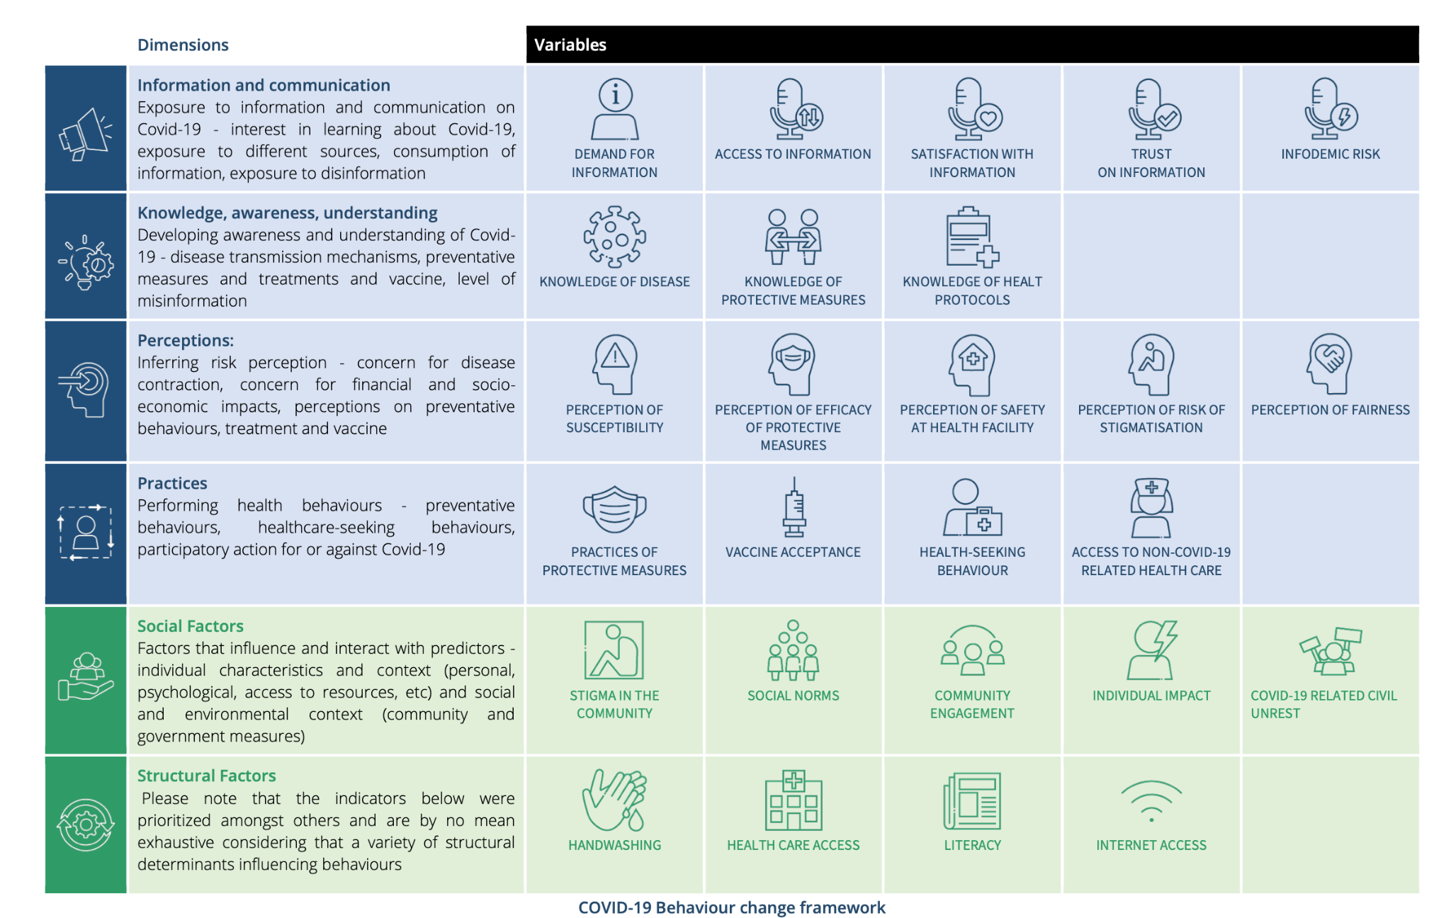
Indicators (COVID-19 example)
Notes:
When you are assessing what information exists and what is needed it is helpful to go back to the reasons for doing an RQA we looked at just now
Understand key social, cultural, political, and economic dynamics
Identify relevant authorities and trusted leaders for message dissemination;
Gather communities’ understanding of the disease and health decision-making processes;
Inform appropriate and effective response efforts.
And use these to work out what questions you want answer from the RQA. It can be helpful to think of key RCCE indicators to inform your assessment, as these can be tracked later on.
An example of indicators developed for COVID-19 are shown on this slide and can be adapted for cholera
Could do a bit of brainstorm about relevant indicators if you have time.

Slide 13
Terms of Reference (ToR) 1 - Structure
1. Background
…
2. Objectives & questions of enquiry
…
3. Scope of work
…
4. Deliverables
…
5. Timeline
…
6. Budget
…
7. Team composition
…
8. Ethical considerations
…
9. Reporting
…
Notes:
The ToR serve as a comprehensive guide for any research project, - which in our case would be doing a rapid qualitative assessment. It provides clear guiding steps ensuring that all aspects are well-planned, coordinated, and aligned with objectives.
Anyone who has done research consultancy, or data collection through their work will most likely have seen Terms of Reference for it. If your ToR are clear and are followed, then the RQA should have the expected outcome. There are many different ways of setting out a ToR, but the structure you see on this slide is a fairly common way of presenting it.
You will start with providing a quick background and the objectives for the work, ensuring that everyone involved has a common understanding of what the RQA aims to achieve and who your audiences are. It is crucial you should clearly articulate your key questions/areas of inquiry.
Next is the scope of work section of the ToR, which we will break down into more detail.

Slide 14
Terms of Reference (ToR) 2 - Scope of work
The Scope of Work covers the key activities:
Stakeholder Engagement: Engage with key stakeholders from the RCCE pillar and other pillars
Data Collection and methods:RQA using the following methods e.g.
Conduct FGDs with community members; IDIs with key informants such as healthcare providers, local leaders, and affected families.
Observation, other participatory methods…
Boundaries Who / what is included and excluded from the assessment, what locations will it take place in? Which methods in which locations.
Data Analysis: Method for rapid analysis of the data
Reporting: what format will the RQA outputs take? Who will the audiences be?

Slide 15
Terms of Reference (ToR) 3 -
Timeline
Establish timeline, including any key milestones and deadlines
Budget
Outline the budget and resources to ensure the project stays on schedule (remember the focus is on rapid)
Team composition
Who will do the work? Outline responsibilities of the principle investigator, research assistants, analyst, community ‘gatekeepers’ etc.
Ethical considerations
Outline the ethical issues and measures to maintain ethical principles

Slide 16
KEY ETHICAL PRINCIPLES
Consider your current work with communities.
Which ethical principles guide your work?

Slide 17
KEY ETHICAL PRINCIPLES
Ethical principle | Application
Respect for persons Individuals should be treated as independent individuals, not under the control of others People with diminished ability to act independently require special protection | Informed consent The person should have the capacity to give consent and should have the power of choice without constraint or coercion – without feeling forced or persuaded The person should have sufficient knowledge and understanding to enable him or her to make the right decision If someone is under the legal age of adulthood, ‘assent’ should be gained from them, and consent should be gained from a caregiver over the legal age of adulthood Right to withdraw This should be possible at any time during the assessment, without consequence This includes the right to ask for the tape-recorder (if one is used) to be switched off Privacy and Confidentiality Respect confidentiality – participants should be able to choose whether their statements are public and attributable (quoted ‘on record’) or whether their statements are anonymous or not to be quoted (‘off record’). Respect privacy – participants should be able to speak in a comfortable setting free from onlookers; participants should never be forced to reveal information about themselves that the participant does not wish to reveal. Data should be anonymized (where the participant does not request attribution), identifiable information should be removed and data should not be able to be linked to any one person Data should be stored securely

Slide 18
KEY ETHICAL PRINCIPLES
Ethical principle | Application
Do No Harm No harm should be done to participants Beyond this, benefit should also be gained from participation in the assessment. Common questions we ask ourselves include: should this be a social or a personal benefit? Who should decide what the benefit should be? The assessment should be necessary and meaningful – it should be unique and it should contribute to the greater good | Assessment of risks and benefits The nature of risks and benefits should be assessed in a step-by-step way. ‘Risk’ can be defined as: the probability of harm or injury (physical, psychological, social or economic) occurring as a result of participation in research. The potential benefit of the work should outweigh the probability and severity of risks. More information can be found here.
Justice Treat people equally, fairly and respect their rights The risks of research should be negligible | Selection of participants In participant selection, wherever you can include a wide range of people; think about gender, ethnicity, and marginalized groups Think about specific groups who are particularly vulnerable to the impacts of the crisis you’re supporting and make sure you include them

Slide 19
CHALLENGES TO APPLYING ETHICAL PRINCIPLES
Do No Harm
When have you faced this?
Informed consent
When have you faced this?
Confidentiality and privacy
When have you faced this?

Slide 20
ETHICS APPROVALS
Rapid Qualitative Assessments are intended for informing operational response decision making
Data is not intended to be published in academic publications
Ethics review board approval process is not required for RQAs as data needs to be used in as close to real-time as possible
BUT – ethical principles must still be maintained

Slide 21
ETHICS APPROVALS WITH COMMUNITIES
How might ethical principles be maintained with communities involved in RQAs?
Notes:
Talk a bit about what it means to maintain ethical principles - e.g. some IRBs have a very strict view on timing of interview, compensation etc. (e.g. any interview over one hour must be compensated…) - you need to make these decisions based on your judgement of the situation. Don’t apply strict rules, but assess the context and the interviewee’s state: are they feeling comfortable? Do they need to stop/pause? Do they need support (referral to MHPSS, social protection…)? Being RESPONSIVE is more important than following very strict rules.
What kinds of ethical challenges can you expect to arise during an RQA for outbreak response?
Think especially of the ‘do no harm’ principle: what kinds of reactions might you encounter or even trigger during RQA?
Emotional distress
Fear and uncertainty
High level of need and despair
Mistrust
How could we address these? What does respectful, ethical work mean in this context?

Slide 22
ETHICAL APPROVALS AND CONSENT
Acknowledge the leadership of the community
Acknowledge the members of the community
Ask their permission to enter the community
Explain the rapid qualitative assessments that you are planning to carry out and the potential benefits and risks
Seek permission to conduct the rapid qualitative assessments
Consider who you obtain permission from - think about power dynamics in the community: who has the authority to give permission, who is excluded from such decision making? Does permission given from leadership extend to all members?
Explain informed consent and data privacy
Consider establishing formal mechanisms such as community advisory boards to work with throughout the phases of the RQAs: data collection, analysis of findings, development and implementation of recommendations
Ensure time and budget for discussing the findings with communities and supporting locally-led action
Notes:
The last point is really important: ideally work together in a participatory way, but at the very least, go back to the community, talk about overall findings, how their participation has had an impact and how local action can be supported.
Make sure there is time and resources for keeping the lines of communication open. E.g. cholera outbreak - plan and implement the set up of ORPs with the community, and do the same when the ORP is taken down again!

Slide 23
SUMMARY
The ethical principles that guide operational social science assessments include respect for persons, doing no harm, and justice. Including:
Getting voluntary informed consent from participants
Allowing the right to withdraw at any time
Maintaining privacy
Weighing risks and benefits of participating
Selection of participants
Formal ethical approval from an institutional ethics review board is not required for RQAs but ensuring ethical principles are respected is still critical
Community leaders and members participating in RQAs should be involved at each stage of the process: data collection, analysis of findings, development and implementation of recommendations

Slide 24
Debrief and Reflections from Day 1
What did you learn yesterday?
What was something new or interesting?
What questions do you have?

Slide 25
Identification of Gaps
For Cholera or for Drought
What don’t we know?
2. What do we need in order to act?
In small groups, after we hear the Drought RQA findings, we will develop the priority gaps.
Use resource people or key documents

Slide 26
Designing a topic guide

Slide 27
Methods for developing the tool (1)
1. Identify key areas of inquiry, e.g.:
Factors affecting healthcare seeking behavior
Beliefs/perceptions/ practices around an outbreak or a disease
Experiences with the disease, perceived social impacts
2. Identify existing tools/resources 🡪
RESOURCES FOR DEVELOPING RQA TOOLS:
Bank of Risk Communication and Community Engagement Assessments, Surveys, and Feedback Tools
SSHAP Rapid Anthropological
Assessments in the Field
Collective Service Cholera Questions Bank
Notes:
For our purposes, the part on developing the tools for our RQA is our main focus for this week.
The first step in tool development is to identify your areas of inquiry - what are the overarching questions you hope to answer, or areas where there are gaps in information that you need to fill in order to understand community experiences, needs, concerns, and improve response processes?
Try to keep your scope focused - while it’s interesting to ask about every question coming up in every response pillar, think about what needs to be prioritized. Focus on those topics for now.
Refer to the links provided here for some excellent resources (many created/curated by Ginger/SSHAP and the Collective Service).

Slide 28
What is your AOE? What is your target population? What are your key questions?
Area of enquiry (AOE)…? Topic sentence…?
Notes:
FACILITATOR NOTES
The sorts of evidence you will search for depends on what the reason is for doing the assessment.
In the urgent context of a new disease outbreak evidence and data are needed to inform the response FAST.
This is the reason why it is important first to see what information already exists, and what may be relevant to inform immediate response actions.
If, in the case of Cholera for example, there have been outbreaks in the recent past there should be some existing information on socio-behavioual factors, e.g. on levels of knowledge about transmission, perception of risk
Other evidence may be out of date, or from areas with different contextual features.
In some contexts the national RCCE plan may either have mapped the 4Ws - who is doing what, where, why? And this will point you to possible sources of evidence. It may also refer to existing evidence.
Ask the group - of the list on the right, which ones do you think it is important are very up to date, and which ones can be older? Ask them to explain why they have given their answers.

Slide 29
What is your AOE? What is your target population? What are your key questions?
Develop your data collection tool (guides) on the basis of your area of enquiry (AOE) and target population.
Key Informant Interview (KII) Guide
Focus Group Discussion (FGD) Guide
Notes:
FACILITATOR NOTES
The sorts of evidence you will search for depends on what the reason is for doing the assessment.
In the urgent context of a new disease outbreak evidence and data are needed to inform the response FAST.
This is the reason why it is important first to see what information already exists, and what may be relevant to inform immediate response actions.
If, in the case of Cholera for example, there have been outbreaks in the recent past there should be some existing information on socio-behavioual factors, e.g. on levels of knowledge about transmission, perception of risk
Other evidence may be out of date, or from areas with different contextual features.
In some contexts the national RCCE plan may either have mapped the 4Ws - who is doing what, where, why? And this will point you to possible sources of evidence. It may also refer to existing evidence.
Ask the group - of the list on the right, which ones do you think it is important are very up to date, and which ones can be older? Ask them to explain why they have given their answers.

Slide 30
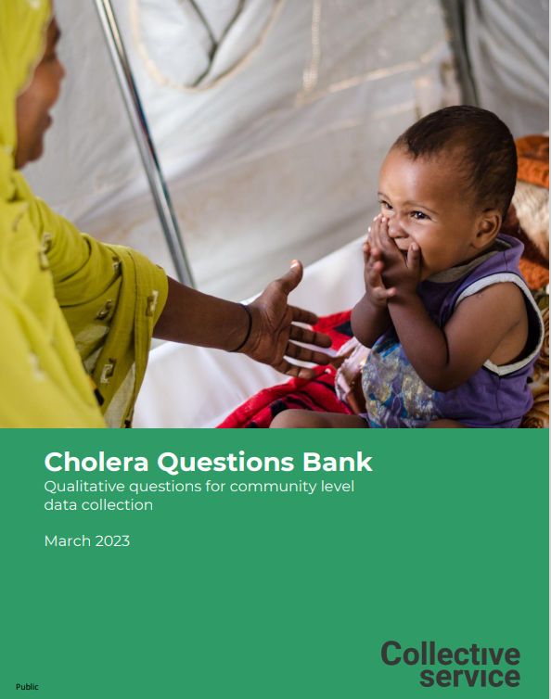
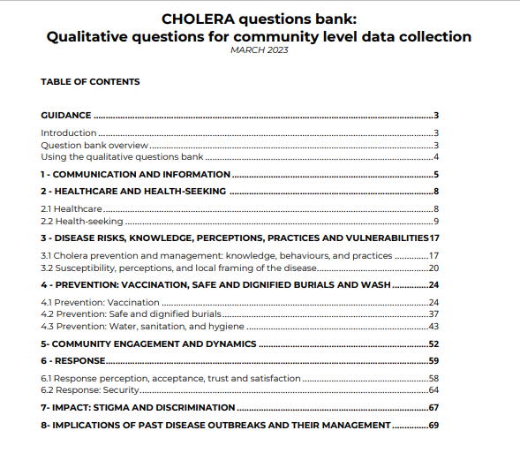
Methods for developing the tool
Develop the data collection tool
Whenever possible, keep questions open-ended (not yes/no 🡪 not a survey)
Identify and include probes and alternate wording for questions that may be challenging to interpret
Notes:
Now that you have your areas of inquiry set, and you know who your target audience is for the RQAs (when you determined your scope in your TOR) and you’ve taken a look at existing resources and decided you need to create a tool that doesn’t already exist, you can refer to question banks to inform the development of your tool - use existing questions, create your own, or pull and adapt questions from multiple tools, as appropriate
Whenever possible, stick to open-ended questions (not yes/no). This can be hard to do! If you are stuck on a yes/no question, consider appropriate follow-up questions you can include in the tool to gain a deeper understanding.
As you develop questions, identify potential probes, which can be used to prompt for more in-depth responses from participants beyond the initial question. Also consider how a question could be re-worded whilst maintaining the original meaning of the question, should the interviewee not understand. These alternate wordings can be noted in the tool

Slide 31
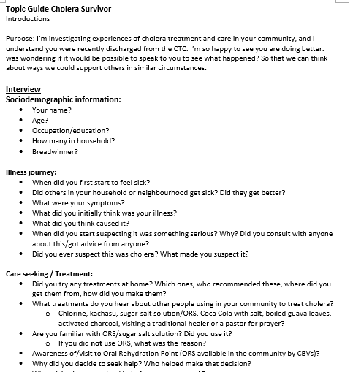
Methods for developing the tool
Develop the data collection tool (cont’d)
Start with sociodemographic questions (less emotionally charged, build rapport)
Group questions by thematic area
Order questions chronologically when possible
Review and revise tools with team
Pilot test and adapt as needed
Notes:
Starting with socio demographic questions helps to frame the rest of the conversation, and understand a bit about the perspective they are coming from.
These Qs are also less emotionally charged, which gives you a chance to establish a comfortable conversational flow and develop a rapport before getting into more sensitive questions
When feasible, group questions by thematic area - this will make it easier to navigate the conversation and keep it on track if the interviewee starts to answer multiple questions or jump around with their answers
When you are asking about outbreak experiences, or specific illness journey experiences, try to keep questions chronological - as you would follow someone telling you a story about something that happened - what happened first? Then what? Etc
Review and revise the tools with the data collection team. This is an important step! As you begin to go through the tools with a group, you’ll identify where the questions don’t flow well are unintentionally repetitive, or may be difficult to interpret. Make as many changes as you need. And be aware of how long it takes even just to go through the questions - how much time do you intend to allocate for each interview? Are there questions that are not necessary that you can remove?
PIlot test with a community similar to your target interviewee demographics. Again, adapt the tool as needed after this!

Slide 32
Using findings
Communication of findings should promote:
inclusive health emergency management
meaningful engagement
community centred practice
Consider:
Who are your key audiences / stakeholders? What are their:
Interests and priorities
Opinions
(Political) motivations and goals
Blockages for action
Language
What format works best for your audience - use different formats for different audiences.
Use different events and existing channels to have maximum impact
Notes:
We are now going to take a leap, assuming you have developed and tested your tool, collected your data from various sources, and analysed it. These steps are covered in detail in separate sessions.
A major limitation we often see is that assessments are done, but the evidence isn’t used. Who has experience of that? Take some answers from the room…
We are going to spend the last part of this session thinking about how to help ensure that findings are used, and lessons are learned.

Slide 33
Communicate findings
Key findings should be linked to concrete recommendations and to its potential impact
Example recommendation:
‘RCCE actors should provide guidance on how people can access vaccinations. Communications should address concerns about vaccine safety and side effects. Emerging types of misinformation around vaccines should be tracked, and approaches developed to dispel hesitancy. These measures could help increase uptake of vaccination.’
It helps the intended users understand:
‘This finding is crucial to the outcome of the vaccination programme’
‘There is something actionable we can do about this’
‘That action will have impact’
Notes:
FACILITATOR NOTES
Consider who are the key stakeholders, actors or organisations, including the affected populations themselves.
Think about what format will work best for your audience, and use different formats (written reports, infographics, presentations, animations, etc.) as appropriate. When sharing findings, use existing networks, channels, and events, and time your communications so that they can be used to inform decision-making (e.g. prior to the start of an intervention, before new response plans are drawn up).

Slide 34
Using findings
Recommendations for impact
Make the recommendations fit the context and resources available
Separate short-term recommendations that are easily actionable from the recommendations that may take more time and resources to achieve
Clearly target each recommendation to a specific user – e.g. which recommendations are for fellow community engagement and/or communications actors, which are for government actors, which are for communities and so on…
Where ever possible, develop these recommendations jointly with affected communities, or get their input and feedback.

