Slide 1
Introduction to Rapid Qualitative Assessments (RQAs) Why? How? Who?

Slide 2
Guiding questions
1. Why utilize rapid qualitative methods? What questions need to be addressed for this emergency response? Who/what organizations need to have this information?
2. How (and how fast) can a rapid qualitative assessment (RQA) be conducted?
3. Who is the ‘population’ of concern that rapid qualitative methods should address?

Slide 3
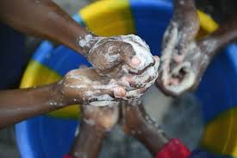
Know your epidemiology…
…know the distribution of WHO (PERSON), WHEN (TIME) and WHERE (PLACE) health risks and consequences are occurring

Slide 4
Why utilize rapid qualitative methods?
Responsive to local contexts for drawing on community resilience mechanisms
Responsive to contemporary (immediate) population-level behaviours as they pertain to the emergency response
More flexible and able to be innovative in response to on-the-ground local conditions (ie. not reliant upon mass standardized surveys)
Able to reveal societal tensions which disproportionately affect specific populations
Useful to study organizational challenges of response efforts to highlight gaps and omissions

Slide 5
Guiding questions
1. Why utilize rapid qualitative methods? What questions need to be addressed for this emergency response? Who/what organizations need to have this information?
2. How (and how fast) can a rapid qualitative assessment (RQA) be conducted?
3. Who is the ‘population’ of concern that rapid qualitative methods should address?
The assessment questions to be addressed should be based on humanitarian actors’ operational needs AND should be proportional and realistic to the scope of that actors’ operation.
Responsive to local contexts; Responsive to contemporary (immediate) population-level behaviours; Reveals social tensions/most vulnerable populations; More flexible and responsive; Useful to study organizational challenges

Slide 7
QUESTIONS?

Slide 8
Guiding questions
1. Why utilize rapid qualitative methods? What questions need to be addressed for this emergency response? Who/what organizations need to have this information?
2. How (and how fast) can a rapid qualitative assessment (RQA) be conducted?
3. Who is the ‘population’ of concern that rapid qualitative methods should address?

Slide 9
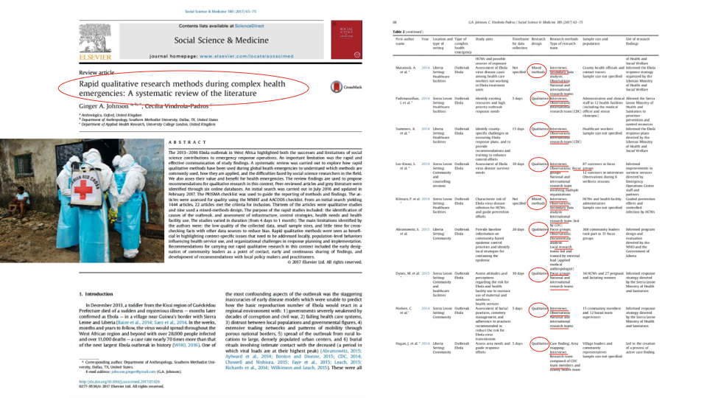

Slide 10
Why look at available data?
To understand the main threats and the effect of certain events faced by population
To draft policies and programs responding to the needs of these target populations
It´s a crucial step before determining the direction of your assessment

Slide 11
What are some routinely collected data for cholera response that you can look at to get started? For drought response?
What information is already available to you?
What are the operational guidelines, plans or policies that should be consulted?

Slide 12
How (Methods)
Use of available data, use of available data, use of available data (secondary data analysis, documentary analysis, etc.)
Your qualitative toolkit can/should include interviews, observations and focus group discussions (this will complement surveys, mapping, etc. which may be deployed by your/other responding agencies)
Form your research team…collect additional data needed, analyze, disseminate findings at regular intervals (and repeat)

Slide 13
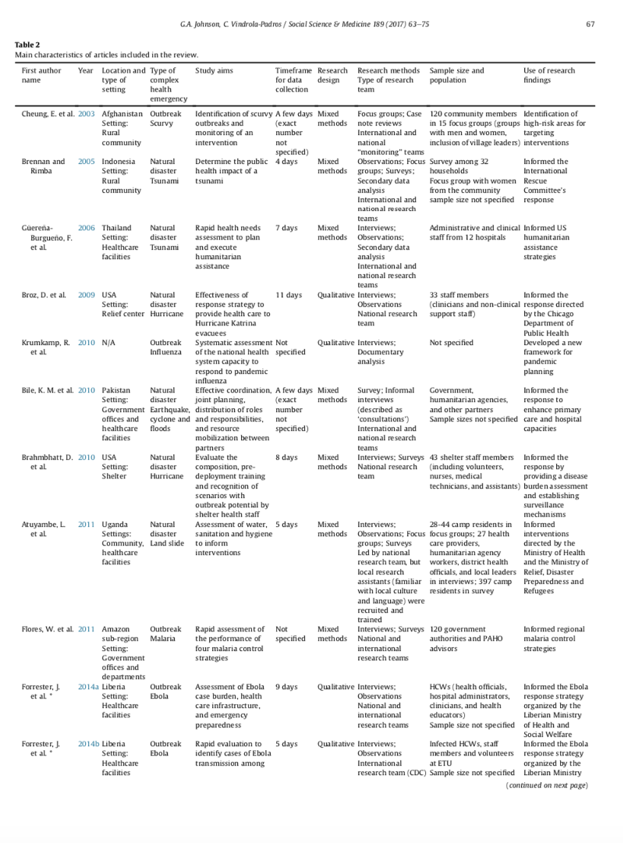
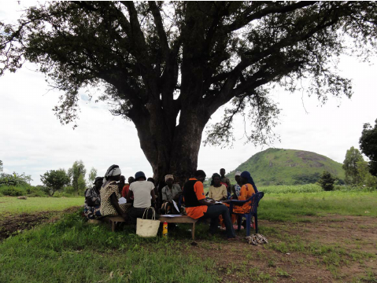
What do we mean by ‘rapid’?

Slide 14
Guiding questions
1. Why utilize rapid qualitative methods? What questions need to be addressed for this emergency response? Who/what organizations need to have this information?
2. How (and how fast) can a rapid qualitative assessment (RQA) be conducted?
3. Who is the ‘population’ of concern that rapid qualitative methods should address?
Use of available data. Use of qualitative ‘toolkit’. Use of research teams (e.g. include core partners based on operational focus, experience, expertise). Can be conducted in a matter of days.

Slide 15
QUESTIONS?

Slide 16
Guiding questions
1. Why utilize rapid qualitative methods? What questions need to be addressed for this emergency response? Who/what organizations need to have this information?
2. How (and how fast) can a rapid qualitative assessment (RQA) be conducted?
3. Who is the ‘population’ of concern that rapid qualitative methods should address?

Slide 17
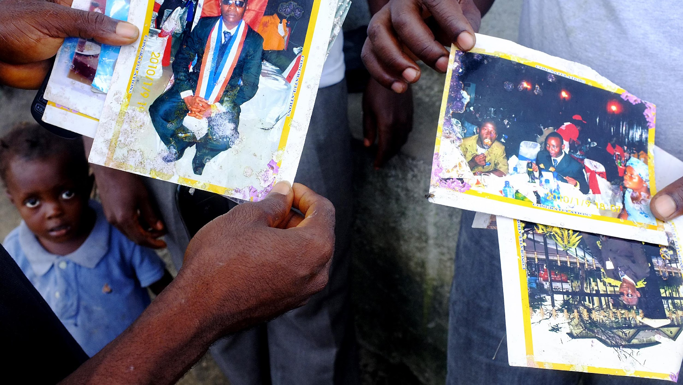
Notes:
Most affected (vulnerable) populations

Slide 18
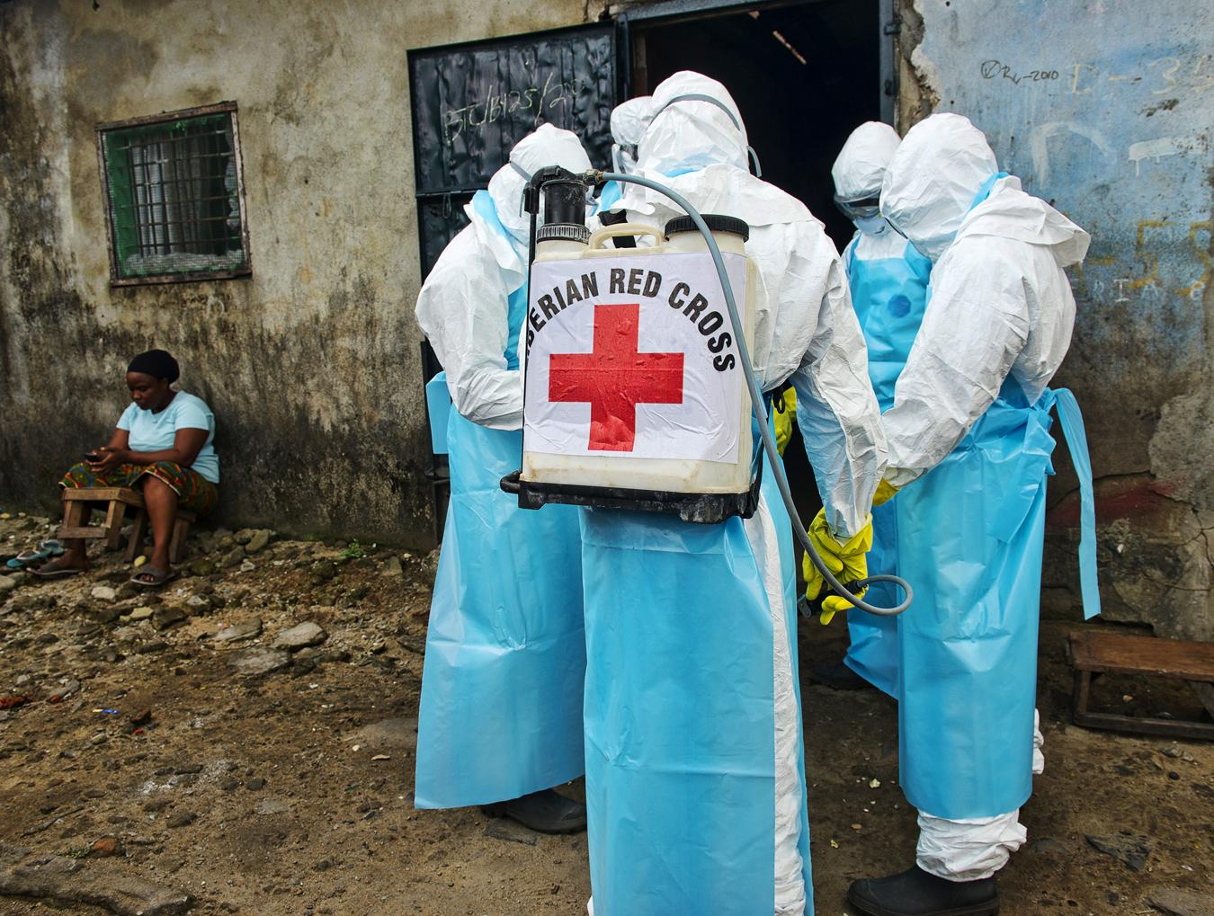
Introduction
Blah, blah, blah
Notes:
Front line workers

Slide 19
Guiding questions
1. Why utilize rapid qualitative methods? What questions need to be addressed for this emergency response? Who/what organizations need to have this information?
2. How (and how fast) can a rapid qualitative assessment (RQA) be conducted?
3. Who is the ‘population’ of concern that rapid qualitative methods should address?
Those who are MOST at risk; Those who are responding to the crisis (on the FRONT LINE WORKERS)

Slide 20
QUESTIONS?

