Slide 1
Notes:
FACILITATOR NOTES

Slide 2
Notes:
FACILITATOR NOTES

Slide 3
LEARNING OBJECTIVES
Introduce yourself and get to know participants and facilitators
Discuss training objectives and how these align to your own expectations and learning goals
Formulate and apply ground rules for fostering a safe and respectful learning environment
Refresh understanding of what Risk Communication and Community Engagement is and why it is important
Notes:
FACILITATOR NOTES

Slide 4
CONTENT
Welcome
Introductions
Opening remarks
Icebreaker
Expectations
Objectives
Ground rules
Notes:
FACILITATOR NOTES

Slide 5
Opening Remarks
Notes:
FACILITATOR NOTES

Slide 6
Objectives
Overall Objective
To contribute to more effective and community centred responses by strengthening systems for utilisation of community data in emergency response by MOH, government and partners.
Training Objective
To build implementing partner capacity to undertake rapid qualitative assessments to better understand community perspectives & needs.
To advocate for prioritisation of collection and utilisation of community data across all pillars of emergency response.
To pilot a training package which can be used to strengthen community data use for other countries in East and Southern Africa
Notes:
FACILITATOR NOTES
After talking through the training objectives ask participants the following questions. If there are topics which participants were expecting to be covered that are not already in the training agenda then add those on to a flip chart paper at the front of the room for facilitators to take note of.
How do your expectations compare with the overall training objectives?
Are your expectations aligned? Are they different?
Is there anything you think needs to be adapted?

Slide 7
Training Roadmap
Day 5
Analysis and results
Developing recommendations
Advocacy
Field work plan
Day 3
Testing tools
Notetaking
Roleplays
Day 1
Intro to RCCE
Intro to RQAs
Ethics
Qual vs Quant data
Participatory methods
Day 4
Piloting tools, field work
Revision of tools
Day 2
Topic guides
Screening criteria
RAP sheets
Notes:
FACILITATOR NOTES

Slide 8
Icebreaker
Who is in the room?
Introduce yourself – name, role, where you work and what experience you have in qualitative research and RCCE
Why did you want to come to this training?
What are your expectations for this training?
Notes:
FACILITATOR NOTES
As an icebreaker:
Ask participants to discuss with the person next to them the questions on the slide – give them 5mins
Then ask each person to introduce the person they were speaking to and one thing they said that surprised them, or they really agreed with

Slide 9
Standard Group Rules
What is Sexual Harassment
any unwelcome sexual advance or unwanted verbal or physical conduct of a sexual nature between Personnel.
Sexual Exploitation and Abuse, which refers to exploitation or abuse of Affected Persons.
What does zero tolerance mean?
If there is an incident of sexual harassment the perpetrator will be excluded from the training and the surge roster
The incident will be reported to their line manager
What to do if it happens this week?
Report it to UNICEF or any facilitator you feel comfortable speaking to
Notes:
FACILITATOR NOTES

Slide 10
Setting Ground Rules
In your groups, discuss the following:
What values are you bringing to the workshop?
How do we demonstrate or uphold these values?
What should the group ground rules be for this workshop?
Notes:
FACILITATOR NOTES

Slide 11
General Info
Information about the venue
Restrooms
Emergency rallying point
Breakfast, lunch, snacks, dinner
WiFi – open access / code
Changing money
Taking photos – consent
The outside world
Notes:
FACILITATOR NOTES

Slide 13
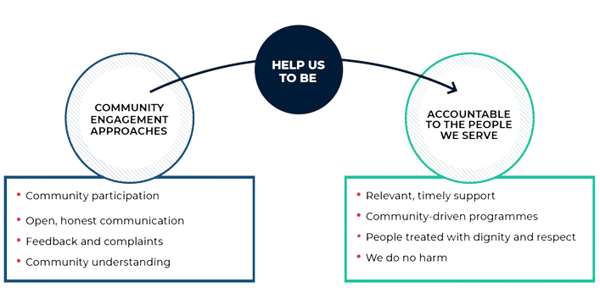
What is Risk Communication and Community Engagement?
Discuss…
Notes:
FACILITATOR NOTES
•BEFORE showing the definition, ask if anyone can explain what risk communication and community engagement means to them – allow 3-4 mins for plenary discussion. As a prompt you can ask 'when you think of RCCE what do you think of'? 'Have you seen/used/engaged with RCCE on deployment or during outbreaks'?
Show the diagram on the slide, which presents the four core components of an RCCE strategy, and how they can help us be accountable to the people we serve.
RCCE is a way of working that recognises and values all community members as equal partners, whose diverse needs, priorities, and preferences guide everything we do. We achieve this by integrating meaningful community participation, open and honest communication, and mechanisms to listen to and act on feedback, within our programmes and operations. Evidence, experience, and common sense tells us when we truly engage communities and they play an active role in designing and managing programmes and operations, the outcomes are more effective, sustainable, and of a higher quality.
Explain:
•Participation is about making decisions together with the community about how programmes and operations are designed, managed and implemented and where possible we support communities to lead and shape their own solutions and changes, on their own terms
•Open, honest regular communication is about ensuring communities understand who we are and what we are doing in their community and have the information they need to make decisions and take action to protect and improve their lives, communities, and health. This includes communicating risk about a disease and how people can take action to protect themselves and their loved ones.
•Feedback mechanisms support us to receive, analyse, respond to, and act on, community questions, complaints, requests, suggestions, beliefs, rumours and praise. This can be about the services and support we provide, beliefs about a specific topic or issue related to our work (for example a public health concern), or about the behaviour and conduct of our staff and volunteers
•Community understanding is about ensuring we understand the communities we are working with, including the situation they live in and their needs, priorities, opinions and capacities – and the wider social, cultural, political, economic and environmental influences that may impact uptake of preventative measures or health-seeking behaviours.
Together these four core community engagement approaches help us to ensure
•The support we provide is relevant, useful and timely and helps people to identify and mitigate local transmission risks
•Our programmes and operations are driven and owned by communities
•That we treat community members with dignity and respect, seeing them as equal partners with valuable knowledge and capacities
•Our interventions do not have negative consequences – such as damaging local markets through aid distributions (e.g. WASH kits) or fuel tensions between different groups

Slide 14
Different name, same aims
Using meaningful community participation, open and honest communication, and mechanisms to listen to and act on feedback to improve accountability to the people we serve
Accountability to Affected People (AAP)
Community Engagement and Accountability (CEA)
Communication with Communities (CwC)
Risk Communication and Community Engagement
Social and Behaviour Change Communication
As above, with a focus on using communication and participatory approaches to encourage positive and healthy behaviours in health programmes or epidemics
Notes:
FACILITATOR NOTES
There are lots of different names for Risk Communication and Community Engagement, but they largely all mean the same thing - the process of working in a transparent and participatory way with communities that improves the quality of programmes and operations.
In the humanitarian system you'll more commonly hear it referred to as AAP or accountability to affected people; the Red Cross and Red Crescent call it Community Engagement and Accountability or sometimes you'll come across a Communicating with Communities working group (but this is a little out of date now as it suggested too much focus on information sharing as opposed to participation)
Social and Behavioural Change (SBC) tends to be used by UNICEF (it was previously C4D or communication for development but they have moved away from this for the same reasons as above) is more focused on participatory approaches to behaviour change in health and WASH programmes
RCCE is a term used primarily in public health emergencies by WHO and other health actors. It has grown in prominence since Ebola and COVID
ULTIMATELY IT DOESN’T MATTER WHAT YOU CALL IT AS LONG AS YOU DO IT!!

Slide 15
Why is Risk Communication and Community Engagement important in epidemics?
Discuss...
Epidemics start and end in communities
Community members must be active partners in the response
Behaviour change is complex
One-way messaging and awareness raising is not enough
The community knows best
Communities know better than anyone how to encourage safer, healthier practices and what could prevent them
Trust is a key ingredient
If communities don’t trust us, they will not listen, contribute, or implement the actions needed to control an epidemic, or may react with hostility and violence
To build trust, we need to listen and act
Feedback is crucial to understand community perceptions and adapt our response to stay relevant and effective
Notes:
FACILITATOR NOTES
First ask participants why they think community engagement is important in epidemics
Community engagement helps to build trust in humanitarian responders, which is particularly important during an outbreak when fear, misinformation and rumours make it harder for people to identify which information is reliable and trustworthy. This can lead people to adopt ineffective prevention measures, which increase their risk of infection. Communities who do not understand or accept health interventions, or perceive them as a threat, have also been known to turn to violence, as demonstrated during the Ebola outbreak in the Democratic Republic of Congo (DRC). This lack of trust limits community involvement and people may not cooperate in activities designed to halt the spread of infection, such as rapid reporting and isolation of cases.
Epidemics start and end in communities: It is the actions of community members that will end – or sustain - an outbreak. For example, whether people are willing to get vaccinated, treat their water, wash their hands etc. In epidemics, the core solutions are social and behavioural. Biomedical tools such as vaccines and other services only work if people decide to use them. Therefore, people need to be actively engaged, understand, and lead the process towards bringing about positive and healthy changes – as we cannot change people’s behaviours for them, they need to do this themselves. To achieve this, we need to see communities are our main partner in fighting the epidemic – not a beneficiary or an audience.
Behaviour change is complex - It is rarely as simple as telling people what to do, and they do it. Evidence shows that blasting out one-way messages that don’t change or reflect the beliefs and conversations at community level do not work. Raising awareness and sharing messages won’t translate into behaviour change. We need to engage and work with people to understand the social and cultural barriers to safer practices and then find solutions that will work. For example, people may face stigma is they wear a mask or lack the finances to stay home and self—isolate if they are sick. Research shows that people do things that their environment allows them to do.
The community knows best - Communities know better than anyone what would be needed to successfully encourage safer, healthier practices and what might prevent them. Communities are the experts of their own contexts. Community leaders know how to mobilize communities, they are already doing it. We need to avoid a parallel system, but rather tap into already existing structures. We otherwise risk conducting activities and providing services that will not be used and accepted, wasting time and resources. Action at the community level will end an epidemic so we as the Red Cross need to use our networks to go much deeper and work in partnership with communities, listen to their ideas, identify community-led solutions and support these to be implemented.
Trust is a key ingredient - If communities do not trust us, they will not listen or contribute to programmes or follow the actions needed to control an epidemic and may even react with hostility and violence. During an epidemic, there are often confusion and rumours about the disease. People will get a lot of different information from media, friends, family, social media, organizations or other sources. Some of these sources may give conflicting information and it can be difficult to know who to trust. When rumours spread faster than the truth and contradict real health information, it can stop people from protecting themselves and undermine the response. If communities do not trust us, it is unlikely they will;
Listen to or follow health advice
Comply with measures like staying at home
Allow us safe access
Report cases or come for treatment
Feel safe to use the clinical services we provide
Without trust – all our interventions may fail
To build trust, we need to listen and we need to act on what communities tell us. Feedback is crucial to understand community perceptions and adapt our programmes and responses to stay relevant and effective. This means systematic community feedback mechanisms, analysis of that feedback and ACTING on it so that communities see we are listening and responding to their real concerns. It’s important to understand the beliefs, fears and questions communities have and use these to shape the information we share and activities we do – responding to issues and concerns before they escalate. This means not just changing what we say (messages) but changing what we do (response approach).

Slide 16
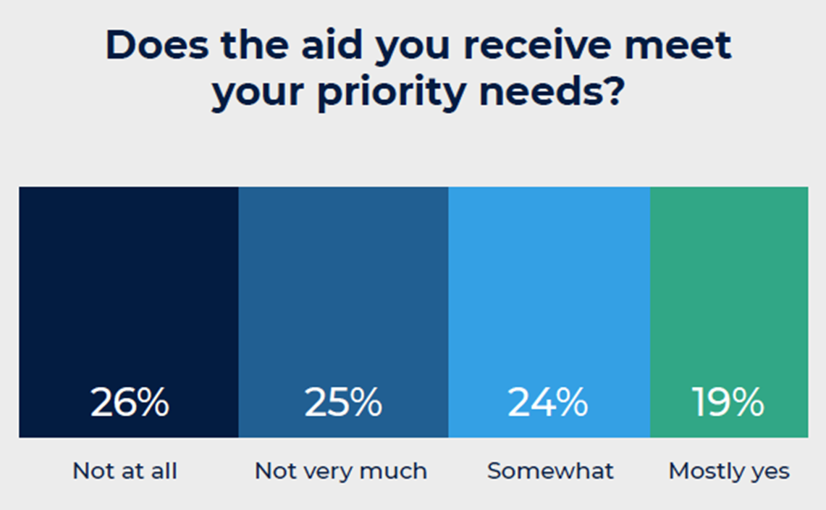
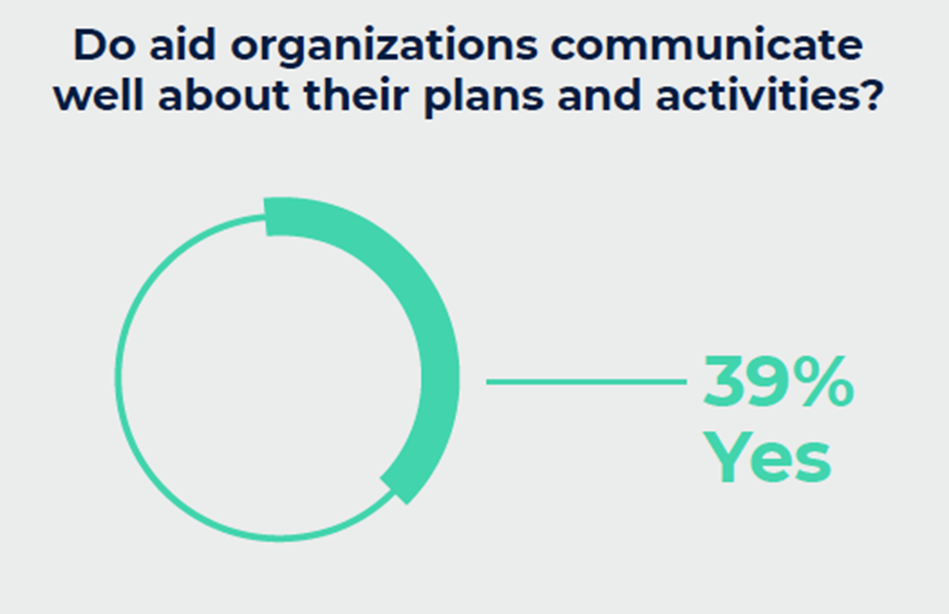
The gap between rhetoric and reality
"There's not enough time to do community engagement – people are dying!"
"We can't change the response plan now as it's already been approved by the donors"
"We already know the community well enough from other outbreaks"
"We are the health experts so we know what is best"
Notes:
FACILITATOR NOTES
Unfortunately, despite global commitments and humanitarian reform agendas concentrating on localisation and community participation, evidence shows there are still significant gaps in how aid organisations engage communities, despite increased awareness and commitments to accountability.
The findings here were collected by Ground Truth Solutions and represent the views of nearly 10,000 people across 10 countries affected by disaster and crisis. As they suggest:
•51% of aid provided does not meet people’s priority needs – that means half of what we do is not meeting the main needs in communities. This represents a massive waste of time, human resource and funding on the part of aid agencies
•61% of people said that aid agencies are not very good at sharing information about their plans and activities
•While the number of feedback mechanisms have increased in recent years…these do not always lead to a response or changes in our programmes. While 93% of aid agency staff were confident people would receive a reply if someone complained – only 42% of people actually did get a response when they submitted a complaint or suggestion, showing our feedback mechanisms are not as effective as we think.
The speech bubbles show common reasons used by decision makers or responders not to fully engage with communities.
Ask participants whether any of the statements sound familiar, or if there are other reasons they have heard about in their work.
Discuss each statement and ask if people have managed to overcome these challenges of rigid donors, lack of time, and assumptions that we already know what people need
Ask participants to continually challenge themselves and colleagues not to make assumptions about what communities think or need

Slide 17
RCCE as an integrated approach
Surveillance
Community involvement in contact tracing
Rapid community insights of transmission patterns & hotspots
Effective community-based surveillance
Case Management
Ensure participation in burials, respecting local customs
Generate insights on patient care, perspectives of caregivers
Insights on local transmission risks & locally-led solutions
Engagement with local healers, birth attendants, caregivers
Community-centred vaccination campaigns
Infection Prevention & Control
Points of Entry
Support effective 2-way communication channels in languages spoken by those crossing at border points
Mapping of local community networks to engage on safe travel and migration
Notes:
FACILITATOR NOTES
Whilst RCCE is now recognised as a central pillar of public health emergencies, it is also a cross-cutting priority that requires a broad range of public health partners to work together with governments and affected communities. Communities must have decision-making power about all aspects of a public health emergency, allowing them to co-design solutions based on their changing needs, local cultural contexts, information flow and availability.
Some example activities for response pillars that are often activated during an outbreak are:
Surveillance: work with rapid response teams to understand transmission patterns, hotspots or affected groups; develop local engagement strategies for key groups and locations (e.g. taxis and public transport) or key cultural or religious events; ensure community involvement of contact tracing to promote early detection and referral of cases; recruitment of local and trusted contact tracers with inclusion of marginal or vulnerable groups helping to avoid tensions between ethnic or political groups.
Case Management: Generate insights on patient care, access to health services and treatment including perspectives of care givers; ensure community involvement in burials and respect for traditional customs (e.g. example from Uganda Red Cross burial of a deceased pregnant woman).
IPC: Support community outreach through traditional healers, home birth attendants and local care-givers who are trusted and have access to vulnerable or at-risk groups; generate social insights on local transmission risks and identify culturaly acceptable or locally-led solutions to mitigate them; understand barriers to vaccine uptake and help to implement community-centred vaccination strategies.
Points of Entry: Support on effective channels, languages or tools to communication information about and at entry and exit points (understanding that migrants, asylum seekers or refugees may have specific vulnerabilities in terms of access to health services or lack of local language skills); mapping and engaging with local and trusted community networks working or living at border areas such as traders associations, lorry or taxi driver associations etc; collecting social insights at key transport hubs such as bus stations, taxi ranks, markets etc.
There are other pillars but these are just examples of the ones we might most commonly be supporting during an outbreak. The list of activities is not exhaustive and will depend on context.

Slide 18
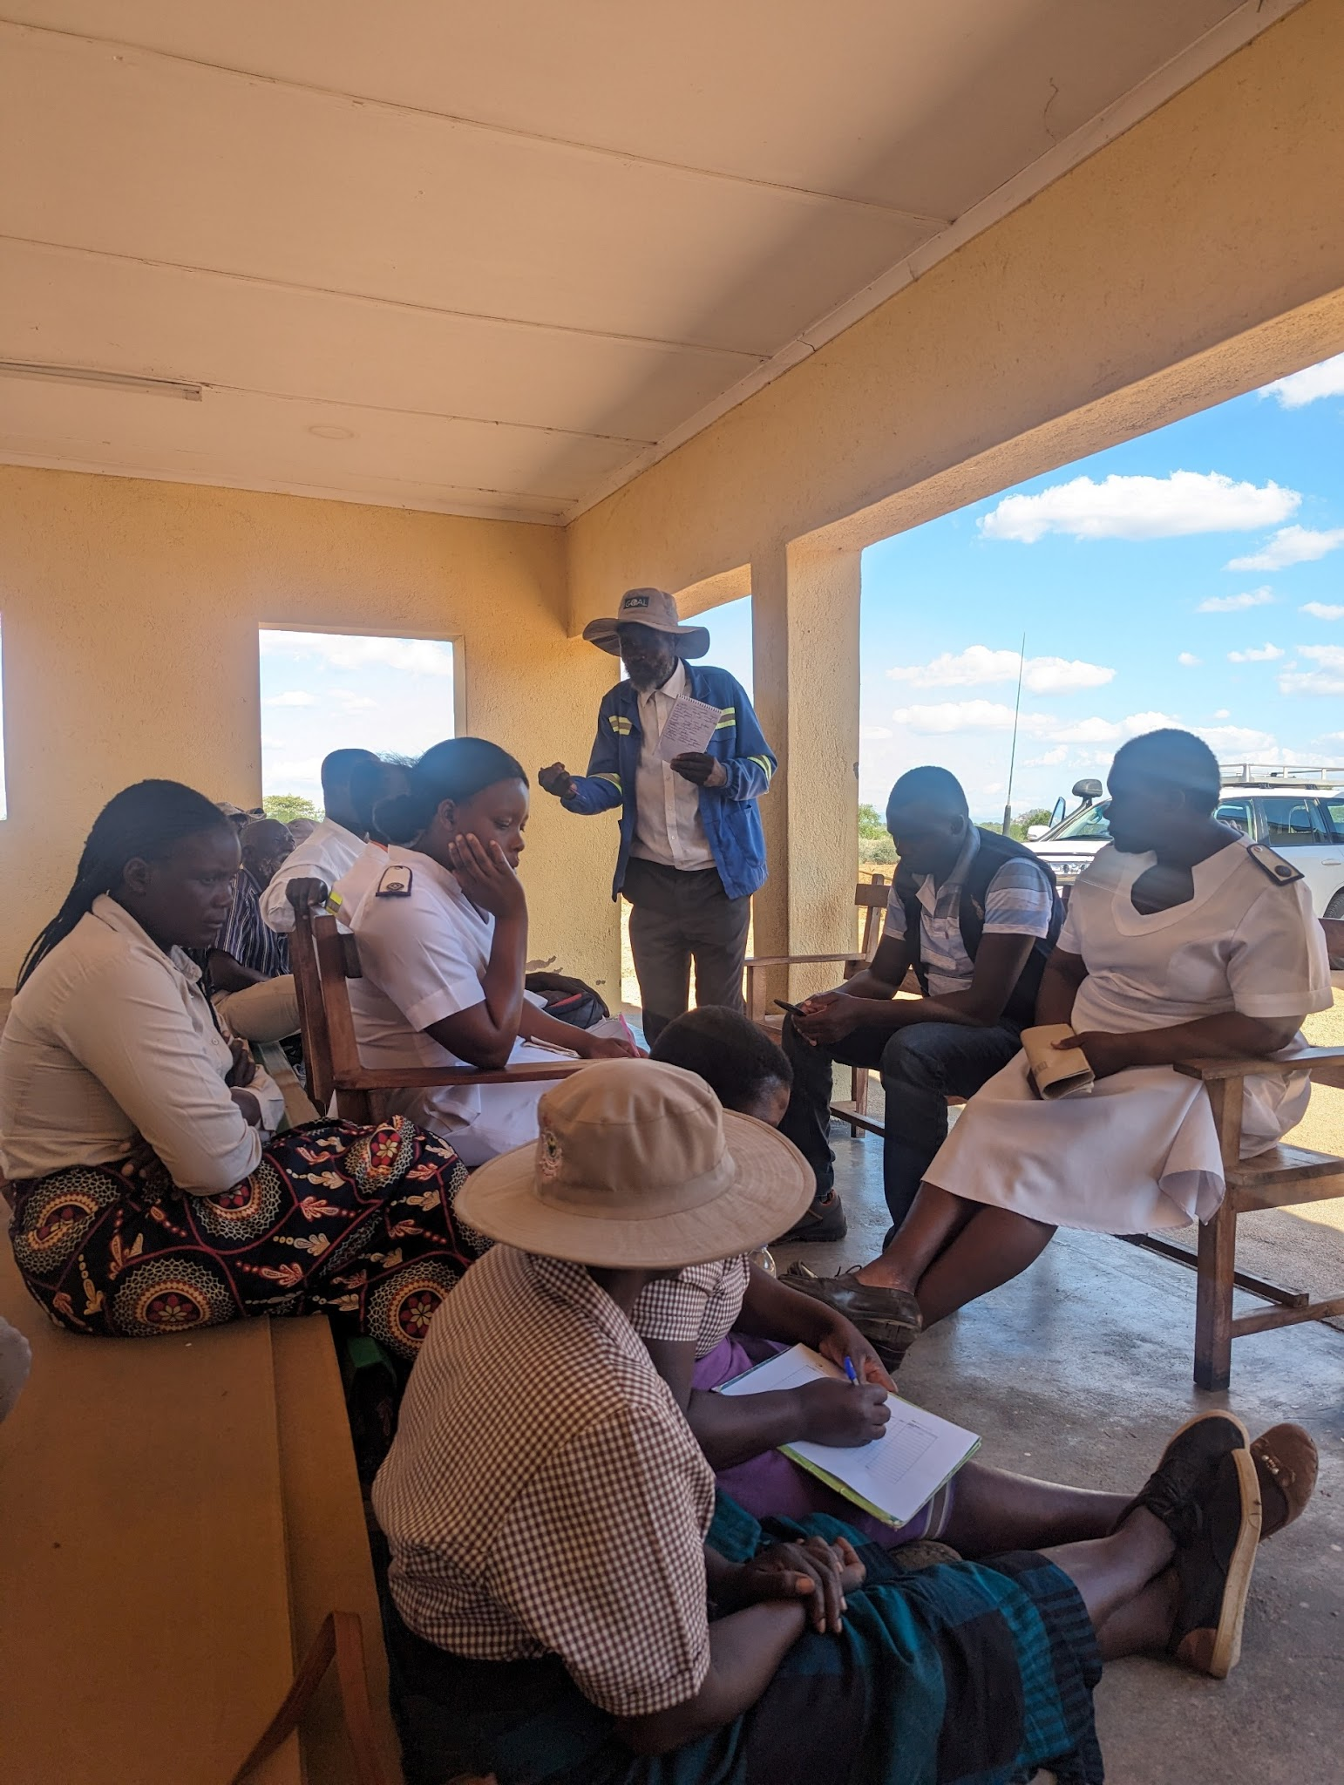
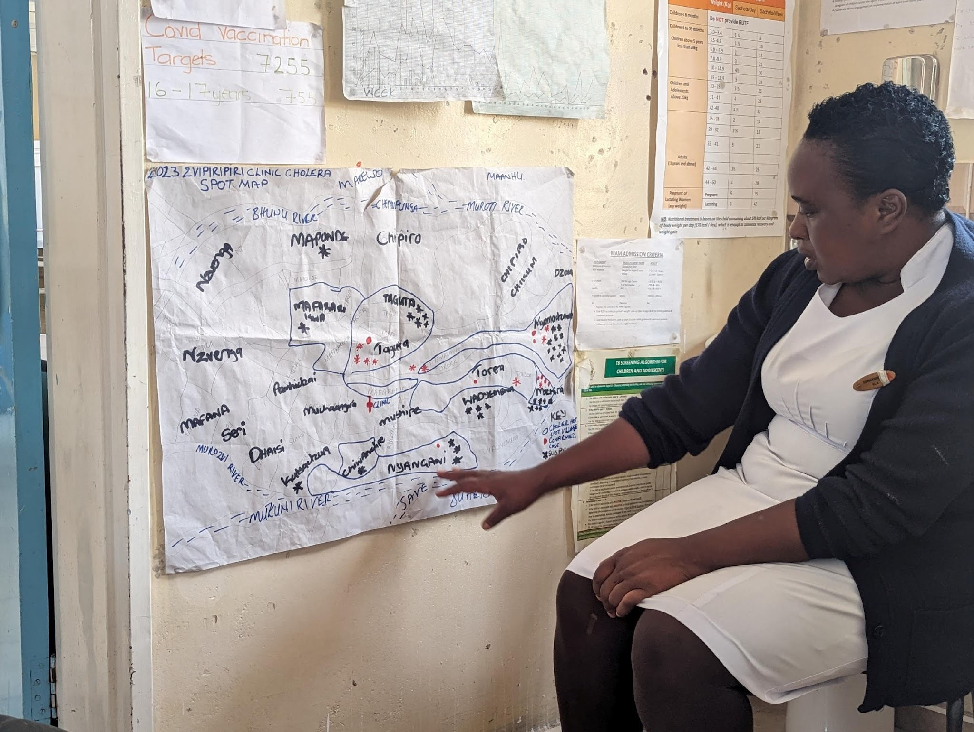
RQAs in action!
Rapid qualitative assessments for cholera in Zimbabwe
Series of rapid qualitative data collection exercises incl. observation, FGDs, and KIIs in cholera hotspots
Data collection tools adapted to focus on key enquiries each round, based on the cholera questions bank
Building on work initiated in Malawi, refined in Zimbabwe, now being deployed in Zambia
Data collected and analysed by multiple partners
Findings disseminated through user-friendly information products and discussed with all pillar leads
A FGD with community leaders
A nurse presents a cholera hotspot map
Notes:
FACILITATOR NOTES
This slide aims to provide some concrete examples of how we are using RQAs in our work. This is a case study from a deployment to Zimbabwe with UNICEF for the cholera outbreak in Oct – Dec 2023. We conducted a series of rapid qualitative assessments – observation, KIIs and FGDs, in cholera hotspots and in CTCs to understand transmission dynamics and causes for high community death rate. The development of the RQA tool has been a process we have tested and refined in Malawi, Zambia and Zimbabwe so it's now quite a well-established approach using the cholera question bank which is a set of qual and quant questions developed by social scientists working for the Collective Service. In this example we were collecting data in rural Manicaland, one of the main hotspots in the outbreaks. Findings included:
Patients in the CTCs said they felt 'detained' as they had no information about how long they would be receiving treatment for and were not aware that visitors and care givers had been banned from CTCs in order to limit spread of infection. Patients felt isolated and lonely. Important to improve patient experience at the CTCs to help ensure other community members with symptoms are not afraid to seek treatment. Made recommendations on organising 'go and see visits' to CTCs, working on Q&A sheets for CHWs to better explain treatment at the CTCs during outreach visits etc.
Many Apostolic communities believed Aquatabs were medicine and refused to use them to treat their water; whereas Waterguard was in liquid form which looked like water and did not look like medicine and therefore were more accepted – supported switch from distributions of Aquatabs to Waterguard in these communities
Access to the CTCs and to ORPs was a huge structural barrier which was preventing many people with symptoms from accessing timely care; many people said they had to travel 2+ hours to reach the nearest CTCs and ORPs were not setup at community level. We heard about a family where a number of members had recently died from cholera. They owned a pick-up truck and were offering free lifts to anyone in their community with cholera symptoms. This was effectively a community-run ambulance service. Mercy Corps – an NGO funded by UNICEF – were able to provide the drivers with disinfectant to keep the truck clean and the drivers safe between visits. Made recommendations to the pillars to ensure flexible budget lines to allow NGOs to support these types of community-led solutions.
Make the point that these are RAPID - it does not need to take a long time (data collection can be done in 2-3 days) or cost a lot of money.
Findings were disseminated through EoC and pillar meetings in 1-page snapshots and PPT presentations. All these recommendations and actions were developed together with the RCCE partners and the respective response pillars

Slide 19
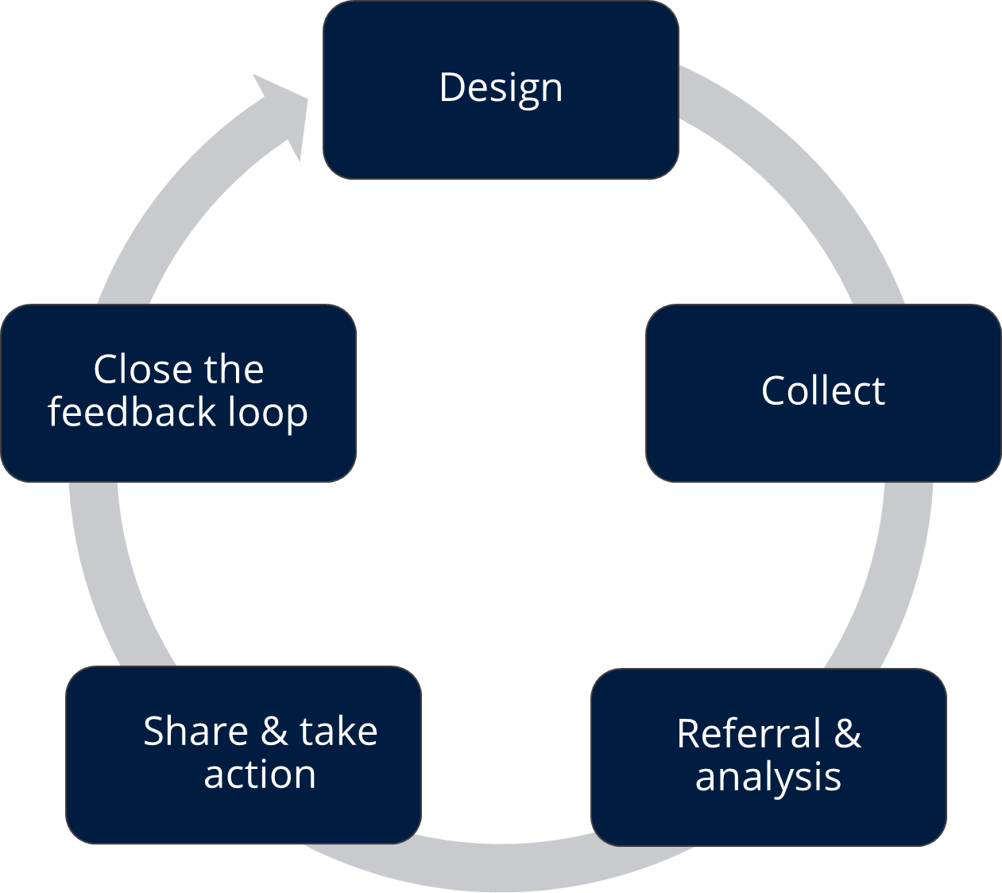
What is community feedback?
Insights generated by community members which can be negative or positive:
Questions
Suggestions
Concerns
Perceptions or beliefs
Praise or statements of thanks
Received through:
House-to-house visits
Hotlines
Helpdesks
Community meetings
...and many more!
The 'feedback loop'
Notes:
FACILITATOR NOTES
Explain that we will now talk about community feedback – which is a source of social science data – and the importance of using it for decision making within outbreak response.
First ask participants if they can give some examples of the different types of information that can be considered community feedback
Explain community feedback are insights generated by community members and can include any type of information, such as questions, suggestions, concerns, rumours or statements of thanks. It can be received in all kinds of ways, for example as part of an informal conversation with a staff member, via a phone call to a call centre, or in the form of responses to structured surveys.
-Community feedback is not different to monitoring data, or assessment data. Anything community members share with us, is community feedback. It can relate to the activities we are conducting, the situation of the community, or other topics relevant to our work, such as public health concerns.
- Provide a quick overview of the different types of information that can be considered as community feedback
1.Questions – what communities needs to know and help us identify information gaps
2.Suggestions or requests – ideas from the community about what needs to be done about specific issues, or what we could do better or differently
3.Observations, beliefs and perceptions – what the community understands and thinks about a situation or a disease. This includes rumours but it is important not to dismiss rumours or consider them negative as they us a lot about how the community perceive and understand the situation. These are often not spread intentionally but reflect what people genuinely believe
4.Encouragement & praise – what communities appreciate, and think should be continued, telling us if we are moving in the right direction
5.Concerns or incidents – reports about problems people have experienced with our services, or complaints about staff or volunteers breaching the Code of Conduct, or concerns related to other stakeholders
We use community feedback mechanisms to:
Ensure we focus on the right activities and messages
Address the misinformation, perceptions and concerns people have about the outbreak
Highlight communities’ capacities and suggestions
Help us improve in real time
Help us build trust
Ensures the right topics are communicated - Situations can change quickly during epidemics and we need to make sure that the information we are providing during our sensitization activities is answering the most frequent questions people have and addressing rumours and misinformation circulating in communities .
Helps us improve – Feedback should be viewed as a positive way to help identify areas where we need to improve and to help build trust and confidence with local communities. Community feedback helps you to judge what is working well and what might need to be adapted. It helps us provide better services and support and use resources more wisely
Addresses problems early – an effective complaints and feedback mechanism can prevent complaints from escalating while also promoting a culture of transparency and accountability. A feedback mechanism can help calm community tension by providing people with an outlet for questions which stopped them developing into rumours
Highlights cases of fraud and abuse – it’s important to have a reporting system so that communities can report any instances of abuse or corruption by staff, volunteers.
Makes our work more efficient and long-lasting – By being aware of the most pressing issues and taking into account communities feedback we avoid wasting our time and resources on the wrong things and build trust by showing communities that have been heard
Protect staff and volunteers - Having a feedback system in place can reduce the pressure on volunteers and make it easier for them to respond to and refer difficult questions or complaints they receive while in the community doing their work.
It’s people’s right - People have a right to complain or feedback on the decisions that affect them, and it is our responsibility to listen – it is in the Code of Conduct and Principles for humanitarian response
THIRD ask participants if they can share any examples of feedback mechanisms they have been involved in:
How did the mechanism work?
What were the benefits?
What challenges did they face?

Slide 20
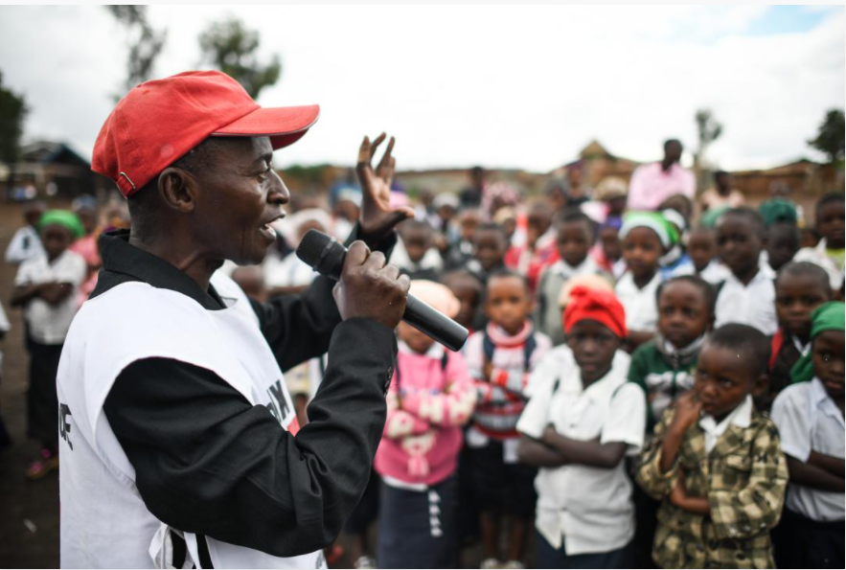
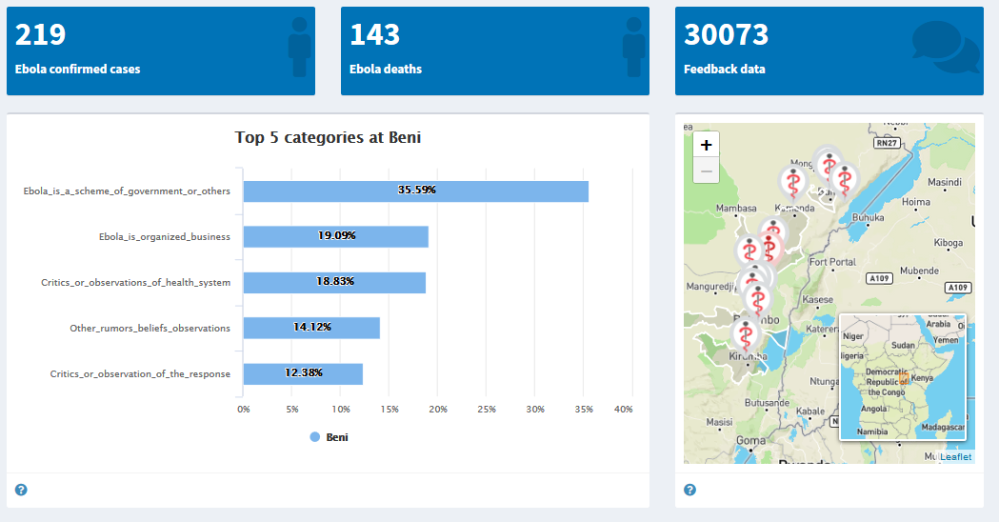
An example from DRC Red Cross
Feedback dashboard in DRC
Bunia, DR Congo: DRC Red Cross volunteers regularly engage with students, providing critical information about Ebola and how to prevent other major diseases. It also gives opportunities for students to ask questions and provide feedback to volunteers who share this in the community feedback system set up with IFRC and CDC
Notes:
FACILITATOR NOTES
DRC Red Cross and IFRC, with the support of US Centres for Disease Control, established a system to systematically collect, analyse and act on community feedback relating to the Ebola operation in Eastern Congo.
During house visits and community meetings, volunteers captured concerns, rumours and questions using paper forms.
The feedback data is coded and analysed locally and shared with local government-led risk communication commissions and Ebola response leaders as well as regional and global partners, to inform strategic discussions and decisions.
By the end of the Ebola response, more than 1 million feedback comments had been collected by over 800 Red Cross volunteers. The feedback data helped the Red Cross operation to respond to community concerns and suggestions in real-time, which built trust and acceptance for health interventions. For example, comments received about family members’ need for visual confirmation that their loved one was in the body bag led the Red Cross to acquire transparent bags. Using transparent bags also helped address perceptions that the bags were filled with rocks or dirt because body parts have been removed and sold
Ask participants if they want to share any other examples of community feedback mechanisms they have seen in their work.

Slide 21
Group exercise
Steps to setup a feedback mechanism
Each group will receive 13 cards with the steps for setting up and running a feedback mechanism
Take 10 mins to discuss what order they should go in
Notes:
FACILITATOR NOTES
-This is intended as a quick exercise to get participants thinking about the process to set up a feedback mechanism
-Hand out the feedback steps group exercise cards – make sure you have cut the steps into individual cards and mixed them up
-Tell participants they have 10 mins in their groups to decide which order these cards should go in

Slide 22
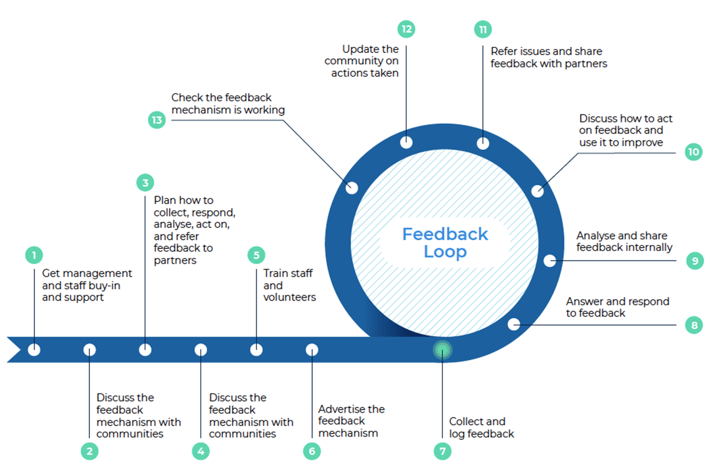
Step to setup and run a feedback mechanism
Did you agree?
Notes:
FACILITATOR NOTES
•Explain steps 1-6 are the steps for setting up a feedback mechanism and steps 7-13 are the ongoing steps or cycle of running a feedback mechanism
•Ask participants if they agree with what appears here
•Ask if anyone had anything different
1.Get management and staff buy-in and support
A feedback mechanism requires staff time, funding, and a commitment to make changes based on what the community say, so it’s important everyone is on board and understands their role.
2. Discuss the feedback mechanism with communities
It’s critical to involve communities in planning the feedback mechanism, otherwise you risk setting something up that doesn’t work, isn’t trusted, or can’t be used by all groups in the community.
3. Plan the feedback mechanism
Plan how feedback will be collected, responded to, analysed, acted on, and referred if necessary, and what needs to be in place to manage this successfully.
4. Discuss the feedback mechanism with communities (again)
Revisit communities to check the planned feedback mechanism meets peoples’ expectations and they will feel comfortable using it.
5. Train staff and volunteers
It’s important everyone involved in the feedback mechanism understands how it works and what their role is, for it to run smoothly.
6. Advertise the feedback mechanism
Communities need to know the feedback mechanism exists and how to access it.
7. Start collecting and logging feedback
Now the feedback mechanism is known about in communities and your teams are trained you can start collecting and logging feedback from the community.
8. Answer and respond to feedback
When possible, feedback should be responded to immediately. Training and having a frequently asked questions guide can help volunteers to answer common questions on the spot. Questions that can’t be answered immediately should be logged and responded to later – don’t make an answer up. Issues that require a change or action should be discussed in team meetings – see step 10 below. Response times will depend on the context but should not be more than 2 weeks. Sensitive feedback should be referred quickly and acted on immediately.
9. Analyse and share feedback internally
Feedback should be analysed regularly – ideally once per week if possible. All feedback, regardless of how it was received (e.g., face-to-face through volunteers or via a telephone hotline), should be logged in the same place so it can be analysed regularly for trends. For example, consolidate all feedback in a database, such as excel, where you can code different types of feedback and track responses and actions. Sensitive feedback should be stored and handled separately. Regularly share updates on community feedback with the full operations team, including with volunteers.
10. Discuss how to act on feedback and use it to improve
Make feedback a standing agenda item in operations meetings with enough time to present the feedback trends and decide how to act on them. Community feedback should be seen as a part of monitoring and reviewed alongside other monitoring data and included in situation reports.
11. Refer and share feedback issues with partners
Refer feedback that goes beyond the scope of the National Society or concerns other agencies or organizations. For example, by sharing feedback in external coordination meetings or mapping other organization’s feedback mechanisms or focal points
12. Update the community on actions taken
Taking action is the best response as it shows the response has listened – but still tell people what action was taken to reinforce trust in the feedback mechanism.
If feedback can’t be acted on, it’s important to tell people this and explain why nothing can be done or they’ll lose trust in the response.
How updates and responses are provided depends on community preference, the type of feedback, and response capacity. For example: specific questions or complaints can be answered directly to the individual who made them, common issues raised by lots of people, can be responded to publicly through a community meeting or noticeboard, while sensitive feedback should always be responded to confidentially, by a trained expert
13. Check the feedback mechanism is working
Carry out regular checks to make sure the feedback mechanism is working, and people still feel comfortable using it.

Slide 23
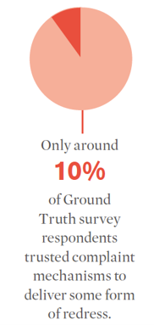
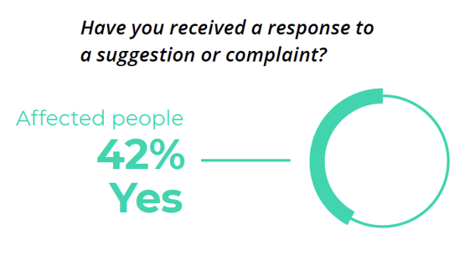
What is the biggest challenge in collecting rapid social insights?
…Acting on the data!
Notes:
FACILITATOR NOTES
Ask participants if they know what some of the main failures or challenges are with implementing rapid social science assessments or setting up community feedback mechanisms?
What challenges have people in the room experienced?
The main challenge is making sure that we act and make changes based on the insights and feedback we receive. The data is useless unless we act on it.
Global evidence shows there are still significant gaps in how aid organisations engage communities, despite increased awareness and commitments to accountability. The following data, collected by Ground Truth Solutions, represents the views of nearly 10,000 people across 10 countries affected by disaster and crisis. The 2018 State of the Humanitarian System report also found a statistically significant correlation between:
Participation and better programming: People who reported they were consulted and able to give feedback were two to three times more likely to be positive about the relevance and quality of aid received, than those who had not
Being consulted and feeling respected: People who were consulted and able to give feedback were more than three times likely to say they were treated with dignity and respect than those who had not

Slide 24
Case study: Zambia cholera outbreak
What would you do to respond?
Context
Increasing cases, especially in Lusaka hotspots with high case fatality rates linked to late health facility attendance
Community feedback from families showed overall good levels of knowledge
Price of chlorine almost doubled during the outbreak
Most at-risk of cholera are least likely to afford to protect themselves
Other feedback from community:
People using kachasu (homemade spirit) to prevent and treat cholera
Some had taken self/loved ones to health facilities: given antibiotics, sent home
Transport was challenging: roads impassable, local taxis wouldn’t collect people, $$
Belief that the central CTC delivered very poor care and you would die if you went
Notes:
FACILITATOR NOTES
Case study from our recent deployment in Zambia. Increasing numbers of cholera cases, especially in hotspots in Lusaka with high case fatality rates linked to late health facility attendance.
These were said to be linked to low knowledge and low risk perception….
However, RQAs from families in hotspots highlighted:
Overall good levels of knowledge (with some misconceptions)
BUT: people most at risk of cholera are least likely to be able to afford to protect themselves and prevent transmission
Most frequent community feedback is “We need chlorine” (price of chlorine had almost doubled during the outbreak)
Other feedback from community
People said that they were using kachasu (homemade spirit) to prevent and treat cholera, including amongst babies
Some community members had taken themselves and their loved ones to health facilities and been given antibiotics and sent home
Transport was very challenging to get: roads were impassable, local taxis wouldn’t collect people, expensive
Belief that the central CTC at Heroes Stadium delivered very poor care and you would die if you went
Ask participants what they would do to respond to this feedback – ask table groups to discuss for 10 minutes. Then ask each table to share 2-3 recommendations in plenary discussion. If short on time just open up a discussion for 3-4 minutes in plenary
Some suggestions:
- Linking up RCCE teams with WASH teams to distribute chlorine / Waterguard, to ensure that RCCE teams can signpost communities to where they can access water treatment (in Zimbabwe Waterguard was 12 x more expensive than regular bleach so there was an ongoing discussion with the MoH about whether we could promote use of bleach as a way to more cheaply treat water)
Ensuring scale-up of ORPs in locally accessible locations so that treatment was more timely for those with symptoms
Supporting community-led ambulance services or reimbursing taxi drivers to transport those with symptoms
Scale-up of outreach activities with trusted influencers – religious leaders, pharmacists, herbalists/traditional healers etc. - to tackle misperception that Kachazu can treat or prevent cholera
Support enhanced IPC measures in clinics to prevent transmission of cholera in clinical settings to tackle belief that people will die if they go to the clinic ; also organise 'go and see visits' to address fear of what happens at the clinics ; further understand issues around why communities perceive the clinics to give poor care and work with case management to address these; develop strategies to address delayed health-seeking behaviours to encourage those with early onset symptoms to seek treatment

Slide 25
Tools and resources on RCCE
RCCE Collective Service website
Cholera question bank
RCCE coordination in public health emergencies guidance
IFRC community feedback toolkit
The team:
Rachel James, IFRC/Collective Service, (rachel.james@ifrc.org)
Nadine Beckmann, UK-PHRST, (nadine.beckmann@lshtm.ac.uk)
Ginger Johnson, SSHAP, (johnson.ginger@gmail.com)
Olivia Tulloch, WHO/Collective Service, (tullocho@who.int)
Sophie Everest UK-PHRST, (sophie.everest@ukhsa.gov.uk)
Christina Craig, CDC, (prl5@cdc.gov)
Notes:
FACILITATOR NOTES

Slide 26
Thank you!
Questions?
Notes:
FACILITATOR NOTES

