Slide 2
LEARNING OUTCOMES
Be able to identify, access and assess evidence from different sources to inform strategies and policy decision-making
Become familiar with the steps to effectively synthesizing qualitative evidence
Understand the opportunities and challenges for synthesizing qualitative and quantitative evidence in an emergency context

Slide 3
KEY QUESTIONS IN SOCIAL SCIENCE RESEARCH
DATA TO ACTION:
Key questions in social science research
What information is needed?
Who needs this information?
Does this information already exist? Is there a related needs assessment or study?
Who can collect this information?
What methodology and tools should be used to collect and analyse this information?
How to ensure that this information goes back to communities? To inform community-level actions and decision-making of the broader response?
How to ensure that the information is used to make operational and/or strategic decisions?
How to track the information used to ensure that it effectively contributes to operational and strategic priorities?

Slide 4
EVIDENCE
How would you define evidence?
Synthesizing evidence is the process of bringing together the different information available on a topic

Slide 5
EVIDENCE
What are the different types of evidence we might bring together?
Situation reports (SitReps)
Cluster reports or dashboards
Data regularly produced by key responding agencies (UNICEF, WHO, IFRC)
Health system data
Articles published in journals
Grey literature
Relevant websites (e.g. Social Science in Humanitarian Action Platform)
Policies (public policies, guidelines, frameworks produced by governmental orgs)
Media (articles published in newspapers and magazines)
Reports (published and unpublished)

Slide 6
WHAT IS THE PURPOSE OF EVIDENCE SYNTHESIS?
An important first step in the evidence synthesis is the establishment of a clear aim. The aim can help the review team determine the scope of the synthesis and the best approach to select and review the existing evidence.
The scope of a review is normally decided through the development of questions that guide the development of the synthesis.
If the evidence synthesis will be used to generate findings that can be translated into changes in policy or practice, it is good practice to involve all relevant stakeholders in the process of defining the research questions.
During a humanitarian crisis an important consideration will be how quickly you can collect the information that you need to synthesize so that it can inform response activities. Your approach should be tailored to the needs and urgency of the situation.

Slide 7
WHAT IS THE PURPOSE OF EVIDENCE SYNTHESIS?
Case example
‘Training and redeployment of health care professionals to intensive care during COVID-19: A systematic review’ (Handout 1)
Aim
The aim of this review was to provide a detailed understanding of the characteristics of redeployment to Intensive Care Units (ICUs) and training provision during the first year of the COVID-19 pandemic. It sought to identify what worked in redeployment and training, and what are concerns with redeployment planning going forward.
Research questions guiding the review were:
What were the main strategies developed to redeploy staff to ICU?
What were the principles of redeployment?
What were redeployed staff experiences and perceived training needs?
How were these needs addressed?
What worked for redeployment and training?

Slide 8
SEARCHING FOR EVIDENCE
“
Not all evidence is equal. Some is stronger – and more relevant to your challenge – than others.
”
(Breckon et al., 2016, p. 18).
Literature reviews identify evidence without a strictly standardized search strategy or inclusion criteria.
Systematic reviews have:
A clear set of objectives with pre-established inclusion criteria for identified literature
An explicit, reproducible methodology
A systematic search which seeks to identify all eligible literature – that matches the inclusion criteria
A formal assessment of the quality of the included literature
Systematic synthesis (bringing together) and presentation of the findings

Slide 9
STEPS (1-4) TO EVIDENCE SYNTHESIS
IS AN EVIDENCE SYNTHESIS NEEDED?
DEVELOPING THE SEARCH STRATEGY
SEARCHING FOR THE EVIDENCE
IDENTIFYING AND SELECTING EVIDENCE

Slide 10
SEARCH STRATEGY
What?
The core concepts which represent your planned evidence synthesis – your key terms
Sub-concept search terms
Appropriate limits
Where?
Sitreps and response dashboards
Data from cluster meetings
Direct contact with partners for locally conducted studies, M&E reports or strategic documents
Important websites (e.g. government, NGO)
Bibliographic databases
Hand-search article references

Slide 11
SEARCH STRATEGY – ADVANCED ONLY
Operator | What it does
AND | Joins concepts together so that the database knows that both concepts need to appear in identified results – e.g. ‘social distancing’ AND ‘perception’
OR | Used to join keywords so that the database knows that either or both concepts need to be in the search results – e.g. ‘social distancing’ OR ‘physical distancing’
NOT | Can be used to remove studies with a given keyword which does not suit a review
* | Can be used for words with alternative endings or spelling, e.g. mask*, face covering*
“ “ | To search for keywords with multiple words, e.g. “acute watery diarrhea”

Slide 12
SEARCH STRATEGY – ADVANCED ONLY
Case example
‘Training and redeployment of health care professionals to intensive care during COVID-19: A systematic review’ (Handout 1)
The search strategy consisted of key terms referring to intensive care AND training AND redeployment AND health care workers. In this rapid review, we began with these broad concepts and then refined them until developing a more specific search strategy like the one in Box 1. The search strategy was simplified when necessary for grey literature databases.
BOX. 1:
Example of a search strategy and how it was used across different databases
"Intensive care" OR "acute medical units" OR "critical care" OR "critically ill" OR "critical illness" OR "intensive treatment unit" OR "intensive therapy unit" OR "high dependency unit" or ICU or ITU or HDU
Training OR education OR course OR prepar* OR "clinical competence" OR "education intervention" OR "training intervention" OR Skill OR "competency-based education" OR "simulation" OR "simulation training"
Redeploy* OR deploy* OR reallocation OR reallocate
staff OR "Healthcare worker" OR HCW OR "healthcare professional" OR clinician OR nurse OR anaesthetist OR doctor OR trainee OR AHP OR allied health professional
Search 1 AND 2 AND 3 AND 4
Time limit Dec 2019-Dec 2020

Slide 13
IDENTIFYING & SELECTING EVIDENCE
Having successfully searched for potentially relevant data/evidence and stored this on a data management software program, it is now time to identify and select the data/evidence that is actually relevant to your evidence synthesis.
The inclusion/exclusion criteria may consider
The population group and context
The topic of research (e.g. a disease, or particular intervention)
The associated phenomenon being explored (e.g. attitudes, knowledge, experience, facilitators/barriers, accessibility)
Type of qualitative data
The outcome of the quality assessment (as discussed later)

Slide 14
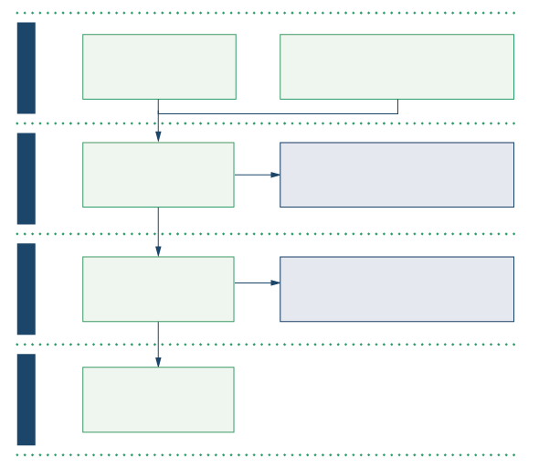
CASE EXAMPLE:
‘Training and redeployment of health care professionals to intensive care during COVID-19: A systematic review’ (Handout 1)
Inclusion/exclusion criteria
Studies and commentaries published in peer-reviewed journals or official reports were included in this review if they were focused on redeployment to Intensive Care Units and related wards during COVID-19. Publication date was restricted from December 2019 to 8 December 2020 (the date the search was conducted). There were no restrictions on language. Articles were excluded if the focus was on redeployment to other areas of care, other viral infection emergencies, or changes in health care activities such as shifting to remote working.
Results
Figure 1. Preferred Reporting Items for Systematic Reviews and Meta-Analyses (PRISMA) flow diagram of the screening and selection process conducted in this systematic review.
N=326 total after duplicates removed
N=3 identified through reference searches and prelimanary review
IDENTIFICATION
N=329 records screened Title and abstact.
N=307 records excluded did not meet initial screening criteria.
SCREENING
N=22 full text articles assessed for egibility
N=2 full text articles excluded
ELIGIBILITY
N=20 included in review
INCLUDED

Slide 15
STEPS (5-8) TO EVIDENCE SYNTHESIS
EXTRACTING DATA
SYNTHESIZING QUALITATIVE DATA
ASSESSING THE QUALITY OF EVIDENCE
REPORTING FINDINGS OF SYNTHESIS

Slide 16
EXAMPLE DATA EXTRACTION FORM

Slide 17
EXTRACTING DATA
Case example
‘Training and redeployment of health care professionals to intensive care during COVID-19: A systematic review’ (Handout 1)
Preliminary list of data to extract (one column per item in Excel):
Citation details
Location of study
Data collection methods / source of data (for secondary data analysis studies)
Data analysis methods
Population
For research question 1: redeployment
Redeployment process
Redeployed staff
For research question 2: Training
Training programmes offered/developed
Training programme evaluations
Learnings – what worked

Slide 18
THEMATIC SYNTHESIS OF QUALITATIVE EVIDENCE
“
“
In essence, this method involves identifying key concepts from studies and translating them into one another. The term ‘translating’ in this context refers to the process of taking concepts from one study and recognising the same concepts in another study, though they may not be expressed using identical words. Explanations or theories associated with these concepts are also extracted and a ‘line of argument’ may be developed, pulling corroborating concepts together and, crucially, going beyond the content of the original studies…
…a method for identifying, analysing and reporting patterns (themes) within data.
”
(Braun & Clarke, 2006, p.79).
Coding text
Developing descriptive themes
”
(Thomas & Harden, 2008, p.3).

Slide 19
CODING TEXT
Go through your extracted data line-by-line and apply ‘codes’ which represent the meaning of the text selected. ‘Codes’ are simply terms generated by the researcher which are then consistently applied across all the extracted data.
For example, you are reading through extracted data in order to better understand the experiences of redeployed staff, and the first few lines describe staff experiencing ‘anxiety’. Hence, you create a ‘anxiety’ code and apply this code to this segment of text.
Codes can be applied to just a few words, a few sentences or an entire paragraph where appropriate.
Sometimes segments of text may represent more than one concept. In this instance, more than one code can be applied to the same segment of text.
Codes will repeat themselves across data extracted from different evidence bases and this can help you to organize the data and identify concepts which carry over from one study to another.
It is good practice to re-check your application of codes and see whether codes generated further into the process may apply to earlier data.

Slide 20
DEVELOPING DESCRIPTIVE THEMES
Now, your job is to look for relational similarities and differences between your codes and to organize the codes into ‘descriptive themes’.
A descriptive theme is simply a higher-level term which captures the essence of a number of related codes.
A theme may have a number of sub-themes:
For example, you have codes named ‘anxiety’, ‘stress’, ‘burn-out’, ‘depression’, ‘satisfaction’, ‘pride’ and ‘purpose’ as codes
You may choose to merge the codes ‘anxiety’, ‘stress’, ‘burn-out’ and ‘depression’ under a descriptive theme called ‘DISTRESS’
You may merge ‘anxiety’ and ‘stress’ to represent one sub-theme titled ‘fear’, while using ‘burn-out’ and ‘depression’ as sub-themes
These themes should not overlap with each other and should be internally consistent and coherent.

Slide 21
ASSESSING EVIDENCE QUALITY – ADVANCED ONLY
Mixed Methods Appraisal Tool (MMAT): This tools allows review teams to assess the quality of studies with a quantitative, qualitative and/or mixed-methods design using the same tool
Authority, Accuracy, Coverage, Objectivity, Date and Significance (AACODS): This checklist is designed to enable the critical appraisal of grey literature
Critical Appraisal Skills Programme (CASP) has eight critical appraisal tools for research developed using different types of study designs
More traditional ‘risk of bias tools’ for quantitative data
GRADE: an approach to grade the quality or certainty of evidence and strength of recommendations

Slide 22
REPORTING FINDINGS OF SYNTHESIS
Main dimensions included in reporting standards for systematic reviews?
Introduction
Rationale
Objectives
Methods
Eligibility criteria (inclusion/exclusion criteria)
Information sources (databases, websites, registers, etc.)
Search strategy
Selection process
Data extraction
Quality assessment
Synthesis methods
Results
Selected sources selection
Characteristics of the included evidence
Results of the quality assessment
Synthesis of the main findings
Discussion
Interpretation of the results in relation to other evidence
Limitations of the evidence included in the review
Limitations of the review
Implications of the findings for practice, policy, future research, etc.

Slide 23
REPORTING FINDINGS OF SYNTHESIS
Users interested in using the evidence to inform rapid decision-making processes will often prefer brief summaries of findings, highlighting the most important aspects of the existing evidence as well as evidence gaps.
They also tend to prefer brief reports or visual representation of the evidence, over longer reports or manuscripts.

Slide 24
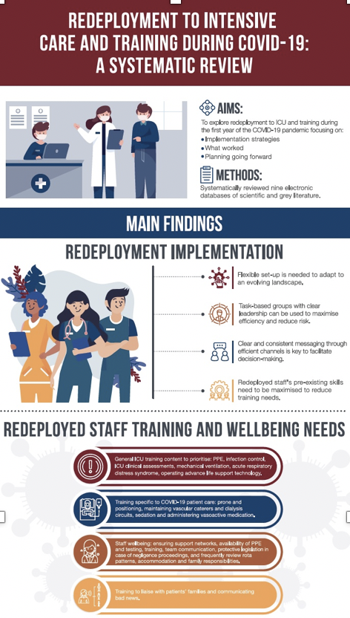
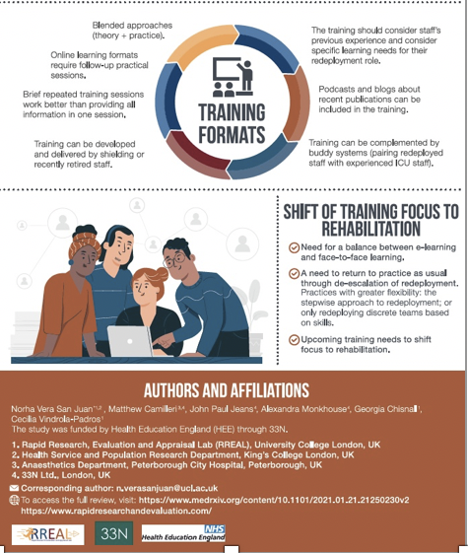
REPORTING FINDINGS OF SYNTHESIS

Slide 25
EVIDENCE SYNTHESIS, BUT RAPID!
Some of the adaptations that can be made to save time include:
Limit the number of questions, interventions, or outcomes considered
Limit the type of questions
Increase the number of people working on the project (if resources allow)
Conduct tasks in parallel/at the same time (e.g., screening, data extraction, risk of bias assessments)
Limit the literature search dates, focusing on more recent research
Language limits
Reduce the number of electronic databases
Use one reviewer for study selection, risk of bias assessment, or data extraction
Can use one reviewer but check 25% of work using a second reviewer

Slide 26
CASE EXAMPLE
Practitioners’ account
What is the data telling us?
What is the quality of the methodology?
Other reflections?
What are some gaps in the data?

Slide 27
SUMMARY
The 8 steps of a qualitative evidence synthesis include:
Deciding whether the evidence synthesis is needed
Developing the search strategy
Implementing the search strategy
Identifying and selecting evidence
Extracting data
Synthesizing data
Assessing the quality of evidence
Displaying and disseminating the findings of the synthesis

Slide 28
SUMMARY
Adaptations for syntheses in a resource restricted, emergency setting might include:
Limiting the number and type of questions
Conducting steps in parallel
Focusing only on very recent research
Limiting the language
Reducing the number of academic databases searched
Other practical adaptations might include:
Accessing data sets direct from organizations producing them, for the latest evidence
Allowing the scope of the review to develop during the search
No formal quality review
Input and validation from partners external to the research team, especially when sharing recommendations

