Slide 1
Data Collection Tips

Slide 2
Field Note - tips
Begin each entry with the date, time, place, and type of data collection event.
Leave space on the page for expanding your notes, or plan to expand them on a separate page.
Take notes strategically. It is usually practical to make only brief notes during data collection. Direct quotes can be especially hard to write down accurately. Rather than try to document every detail or quote, write down key words and phrases that will trigger your memory when you expand notes.
Use shorthand. Because you will expand and write/type up your notes soon after you write them, it does not matter if you are the only person who can understand your shorthand system. Use abbreviations and acronyms to quickly note what is happening and being said.
Cover a range of observations. For example, even if your question is around specific events (e.g. food distributions) you should be documenting informal conversations, people’s body language, moods, or attitudes; the general environment etc
Arrive early and leave late. Some of the most interesting/important observations may occur before or after
Consider using present tense: This can increase the level of detail you capture.

Slide 3
Note Write-ups: Instructions
1.Type up notes:
Include:
Date
Location / Site
Type of activity (FGD, KII with caregiver)
Interviewer name
Notetaker name
Sociodemographics
If you have it in your written notes, include it in your typed notes!
Include your observations
2. After typing up notes, swap with your partner (interviewer/notetaker) to review and add any missing information
Notes:
Ginger to cover

Slide 4
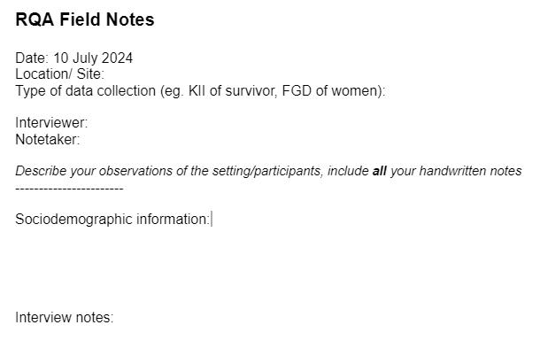
Note Write-ups: Instructions
Notes:
Ginger to cover

Slide 5
Key Informant Interviews (KII) - tips
Be a good listener: be patient, focus on the person speaking, do not interrupt
‘Talk less, listen more’
Start off with an easy question to help informants settle into the interviews. Ask for an example
Let the interviewee lead
Use open ended questions, encourage people to speak and expand on the subject
Avoid leading questions
PROBE to get more detailed information from people
Write detailed notes beyond what people say, including what you observe
Don’t try to teach!

Slide 6
Focus Group Discussions (FGD) - tips
Set ground rules together with the FGD participants
Balance participation across the group
When dealing with dominant people - you can say
‘I can feel you have a lot of information to share about this topic. What about, we meet right after this discussion so we can get more details?’
If discussion goes too far off topic, redirect it
For sensitive topics, e.g. sexual violence, do not ask participants to speak of individual experiences in a group setting. Instead you can ask questions in such a way that you are asking persons to speak about how they think members of their community experience the issue

