Slide 1
Qualitative data analysis (thematic analysis)
Deductive, Inductive

Slide 2
Introduction
To understand and practice the different steps to coding and analysing qualitative data using thematic analysis methods.
Session 1: Deductive and inductive coding with real data examples.
Session 2: Generating themes from coded qualitative data.
Notes:
Introduce the background and the purpose of the 4 sessions we have together.
As a result of the May training, a need was identified to further understand and practice the different steps to coding and a analysing qualitative data.
4 sessions, 4 days around these different steps.
We are going to focus on data sets shared with us by Oxfam to make this as practical and applicable as possible.
Practical exercises for you to spend some time on outside of the sessions.
Introduce facilitators. Round robin introductions of participants?
Small icebreaker. POLEF – Poll everywhere
Todays’ session objectives
To review and reflect on the different steps to code and analyse qualitative data using thematic analysis methods.
To apply deductive and inductive coding to real data examples

Slide 3
Objective of today’s session
To review the different steps in analysing qualitative data using thematic analysis.
To apply deductive and inductive coding to real data examples.
Notes:
Present the objective and provide a quick overview of the session:
Refresh participant’s knowledge on the different steps for analysing qualitative data using thematic analysis.
Deep dive into inductive and deductive coding using practical examples from Oxfam’s programmatic work.
Introduce a practical exercise on inductive and deductive coding which participants will complete individually before the second session.

Slide 4
Steps of thematic data analysis - and how/where do we adapt for RQA
Step 1: Transcription and translation
Step 2:
Coding
Step 3:
Generating themes
Step 4:
Prioritising key findings and writing up themes
Step 5:
Using themes and key findings as an evidence base
Notes:
How do we adapt: no transcription or only selected transcription
Coding done in teams (makes it faster but more important to communicate and develop a book that everyone works from)
Let’s proceed with the aim of the session : to understand and practice the different steps to coding and analysing qualitative data using thematic analysis methods.
Although there are many approaches to analysing qualitative data, we are focussing on thematic analysis.
Thematic analysis is generally considered the best suited for the qualitative analysis of data produced in humanitarian contexts - it is rigorous, conducted step by step, and provides an audit trail for decisions and processes, and is fairly easy to use.
It is a way of producing themes from texts such as interview or focus group transcripts, and making sense of large amounts of information so that responses to a research question or an operational question can emerge.
We can split the steps into 5:
In this session we are focusing on coding

Slide 5
Coding
A code is usually a word or a phrase representing a recurring idea or feature in the data.
Coding can be done in a Word document, an Excel spreadsheet or qualitative analysis software, or even paper and pen.
The approach to coding depends on the amount and type of data you need to analyse, how specific the question is that you want to explore, as well as your preferences as the analyst.
Notes:
Before showing the answer, ask the group what is a code?
Ok, so what is a code?
(Just to note that the terms code, category, theme, are often used interchangeably - when they are actually distinct.)
A code is usually a word or a phrase that represents a recurring idea or feature in the data. For example, let us say you notice a key idea or feature in your participants’ responses is that they have ‘low motivation’ to change their behaviour. Coding involves reading the data, and picking out the different sections that show this idea or feature being expressed. You need to then label those bits of data (so the chunk of text) which you can do through noting initials (‘LM’) next to that text, or colours chosen.
Does anyone have another way of doing it beyond initials or colour coding?
There are, of course, many ways this can be practically done, and the best way will depend on the amount and type of data you need to analyse and how specific the question or theme is that you want to explore as well as the preferences of the analyst. We will give two examples here, using common software programmes, Word and Excel. Coding can also be done using qualitative data analysis software (as described in the final section), or even using pen and paper.

Slide 6

What are some standout features or ideas?
We are exploring risks faced during the displacement journey
People migrated from the settlement to Landheer, Shinbirale, Qaloocan and Shandheeye villages under Buhodle Ethiopia region to find water and land for animal grazing. Hunger and thirst is what we mostly faced during the migration process as there was nowhere to buy food and we had not brought enough supplies. We also feared getting caught up in the war that is going on. Women and children were most affected because they are physically vulnerable. Pregnant women in particular, as they could not move well or quickly. Some gave birth on the journey with no midwife or hospital. Oftentimes, families were splitting up because they could not all move safely together at the same time.
Notes:
Let’s practice with an example
Few mins to read the excerpt from an interview looking at risk faced during displacement
Take hands up for answers/or type in chatbox
Explain after they have called out features or ideas - The idea is that codes would be the common ideas that emerge across multiple data sets or multiple transcripts.
2 or 3 codes: pregnant women being at risk

Slide 7
Codes and sub-codes
Vulnerability of pregnant women – VPW
Code
Women are less mobile when pregnant – LM
Poor access to maternal healthcare– MHC
Sub-Code
Notes:
With good data sets, we often have a hierarchy of codes, with codes and sub-codes.
This is an example of hierarchy of codes we could see in the previous example. You can see how the sub-codes relate to the codes.
You would use a code book as a way to visualise and record the different codes and sub-codes, usually giving a more detailed explanation of each.
We will come back to code books later.

Slide 8
Deductive vs. inductive coding
INDUCTIVE CODING
Means you do not have any pre-defined codes but create the codes as you read through the data.
This method can be useful if your research question is broader, and you adopt an exploratory approach and do not want to be influenced by pre-conceived notions of what might be the most important themes.
DEDUCTIVE CODING
Means you create a pre-defined set of codes before starting your analysis.
This can be useful if you already have a good idea of the questions and/or ideas that you want to explore.
It is possible to use a mix of deductive and inductive coding
Notes:
There are two main approaches to coding.
Can anyone tell us the difference between deductive and inductive coding?
Deductive vs. inductive coding
Deductive coding means you create a pre-defined set of codes before starting your analysis. This can be useful if you already have a good idea of the research questions you want to answer and the types of themes that you want to explore. You might also have an idea of the types of themes that will emerge in your data after reviewing previous research. For example, if you know you want to explore risks faced during the displacement journey you might have some codes around conflict, health issues, hunger etc. You then read through the data and pull out the sections that link to this code. The Qs might already set by a technical partner, or are linked to a specific programmatic Q
What might be a downside of deductive coding?
The downside of deductive coding is that it might create some bias and prevent you noticing new themes emerging that you hadn’t expected. So try to look explicitly for contradictory evidence in the data to minimize bias or missing any important points.
Inductive coding means you do not have any pre-defined codes but create the codes as you read through the data. This method can be useful if your research question is broader and you do not want to be influenced by pre-conceived notions of what might be the most important themes. But it can be more time-consuming as codes emerge and change throughout the process and you may need to go back and re-code data as new insights emerge.
A good compromise is to use a mix of deductive and inductive coding, starting out with a pre-defined codebook, but being prepared to modify it, adding new codes, blending codes or splitting codes as new themes emerge.
Ask participants: What type of coding do you use in your program? When might you use inductive as opposed to deductive?

Slide 9
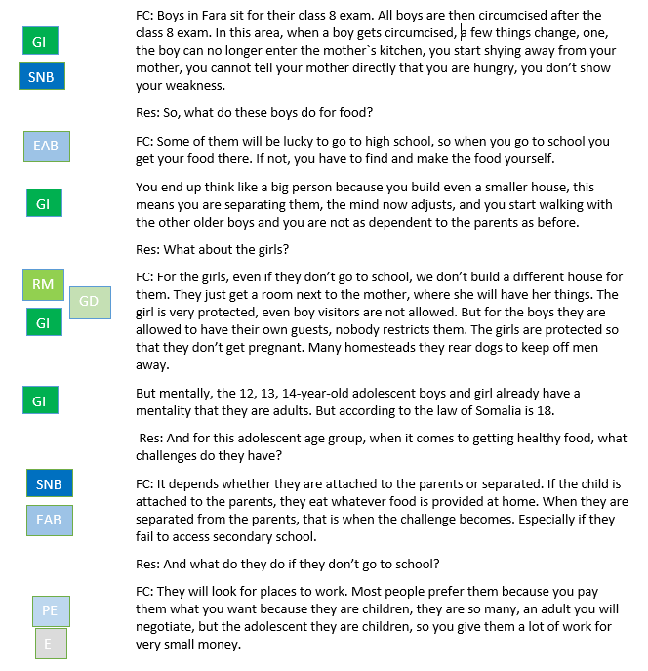
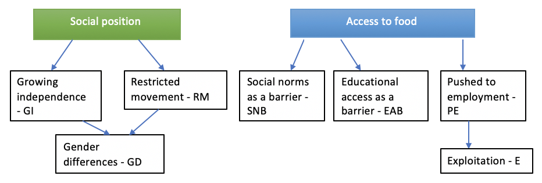

Coding in a Word document
KII – Research topic: adolescent health
Location: Fara Village in Bagara, Somalia
Participant: Fara village chief (FC)
Notes:
So what can coding actually look like?
This example if from qualitative research looking at issues related to adolescent health in Somalia.
In the example there are 5 codes here (say them) and 2 subcodes. They fall under two buckets.
This is how we would code using basic word processing software (e.g. Microsoft Word) or on paper:
If all your data are in Word or a similar word processing software (e.g. typed transcripts), you can place all the text in a table with a column to one side.
As you read through the text, type the relevant codes next to each piece of data relevant to that code in the column to the side.
SNB example from para 1
If you do not have too many codes, it can be useful to use different colours for each code, to help you to visually process the different emerging themes and their frequency. Even highlight the text that colour, will show you shortly.
You can also do this straight onto handwritten notes, by drawing a margin for you to write the codes in.
Note that some bits of text can have multiple codes attached to them.

Slide 10
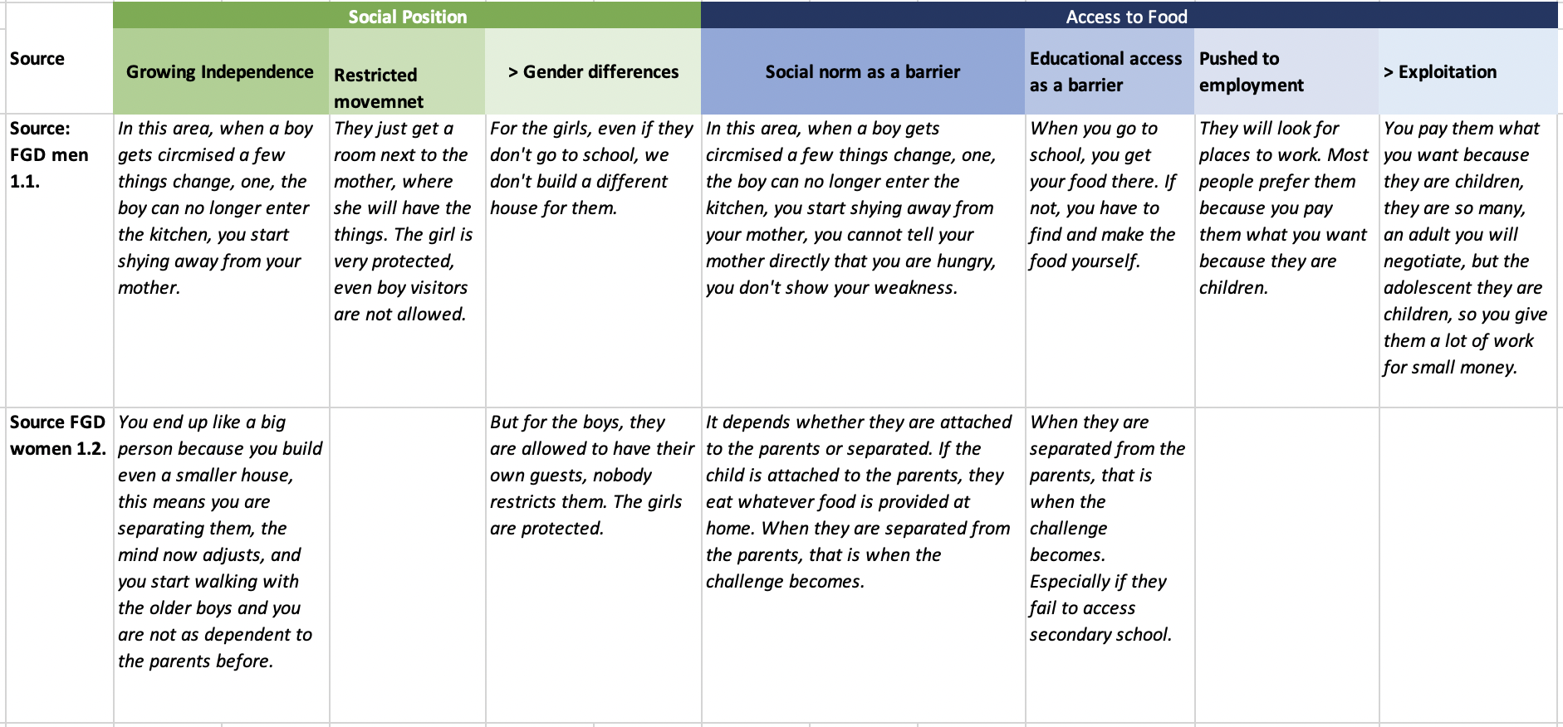
Coding in an Excel spreadsheet
Notes:
Coding using basic number processing software (e.g. Microsoft Excel)
Set up an Excel spreadsheet (or similar) with your codes and subcodes in a row along the top or create new columns as you go.
As you read through each transcript, copy and paste relevant pieces of text under the column with the relevant code, so that all pieces of data relating to that code fall into the same column and can be easily scanned later.
People have different preferences.
How do you do it in Oxfam?

Slide 11
Codebooks
What is a code book? Why use a codebook?
Inductive coding - develop the codebook as you go
Deductive coding - prepare the codebook before you start your analysis.
Or a combination approach
Notes:
Next we will come to codebooks.
Codebooks can be especially important to make sure:
Everyone uses the same codes (if several people do the coding and are involved in the analysis)
Everyone has a shared understanding of what the different labels mean
Jointly agree on any changes or new codes
If this is the case, the team should be in constant communication throughout the analysis phase, to ensure all coders have a shared understanding of what the different labels mean, and to agree on any changes made or new codes added throughout the process.
If you have chosen to use deductive coding, you can prepare a “codebook” before you start your analysis. If you choose inductive coding, you can develop the codebook as you go. This can be as simple as a list of words or short phrases in a Word or Excel document to guide you.
If you have chosen to use deductive coding, you can prepare a “codebook” before you start your analysis. If you choose inductive coding, you can develop the codebook as you go. This can be as simple as a list of words or short phrases in a Word or Excel document to guide you.

Slide 12
Top tips for coding
Code as many interesting ideas/features as possible - you never know what might be of interest later on.
It is ok to code a word, a few words or a sentence it will vary!
Code also the surrounding text so you don’t lose the context of the extract.
You can code the same data extract many times if it fits with several codes.
You will code ideas that are common across the transcripts, but don’t lose sight of the uncommon/outlying ideas too.
Notes:
Finally, some top tips for coding.
Any questions on this or the exercise?

Slide 13
Importance of quality data
What type of data do you usually collect?
What are some of the challenges to getting the right amount and detailed data?
What needs to be done to address this?
Notes:
Have this discussion either at the end of Session 1. or at the beginning of Session 2.
E.g. does using Excel encourage quant like data?

Slide 14
Practical exercise
Coding your data - inductive coding - using RQA data (can use either Word or Excel)
Notes:
Lets keep it a bit more simple.

