Slide 1
Qualitative data analysis (thematic analysis)
Moving from coding to generating themes

Slide 2
Introduction
To understand and practice the different steps to coding and analysing qualitative data using thematic analysis methods.
Session 1: Deductive and inductive coding with real data examples.
Session 2: Generating themes from coded qualitative data.

Slide 3
Objective of today’s session
To generate themes from coded qualitative data using the thematic analysis approach.

Slide 4
Steps of thematic data analysis
Step 1: Transcription and translation
Step 2:
Coding
Step 3:
Generating themes
Step 4:
Prioritising key findings and writing up themes
Step 5:
Using themes and key findings as an evidence base
Notes:
You will remember from last session the different steps of thematic data analysis, which is the qualitative analysis approach we are focusing on for this training.
Generating themes is the third step.
When identifying themes we need to reflect on the following:
Are there are any links between the codes?
What are the conclusions regarding our research or assessment questions?

Slide 5
Step 3: Generating themes
CODES
Basic analytic units.
You can think of them as labels (words or short phrases) given to a piece of text about a particular topic.
Tools for organising your data.
The overarching ideas – the pattern or relationships across the data set.
Emerge when we look over our codes and see how they combine to answer our research/assessment questions.
Tend to be broader and more inclusive than codes (often combining several codes into one) and expressed in longer phrases or sentences.
Involve analysis and interpretation, rather than just using the interview questions.
THEMES
Notes:
But a helpful way to understand what themes are in qualitative research is to understand the difference between codes and themes.
Can anyway tell us what might be some differences between codes and themes?
Codes are basic analytic units. You can think of them as labels (words or short phrases) given to a piece of text about a particular topic. They are really just tools for organising your data. (For example, yesterday we had: ‘restricted movement’ as a code to put to any data that mentioned the restricted movement of adolescents).
Themes are the more overarching ideas to emerge in across our data set. Each theme should have one main idea.
They begin to emerge when we look over our codes and start to group them into categories that are relevant to our research or assessment questions.
They tend to be broader and more inclusive than codes, often combining several codes into one, but not always, and might be expressed in longer phrases or sentences, I will show you an example of this.

Slide 6
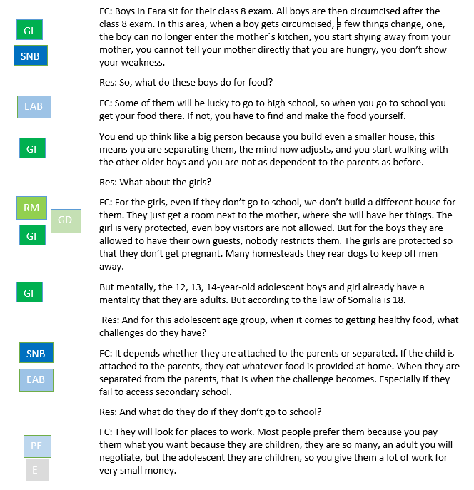
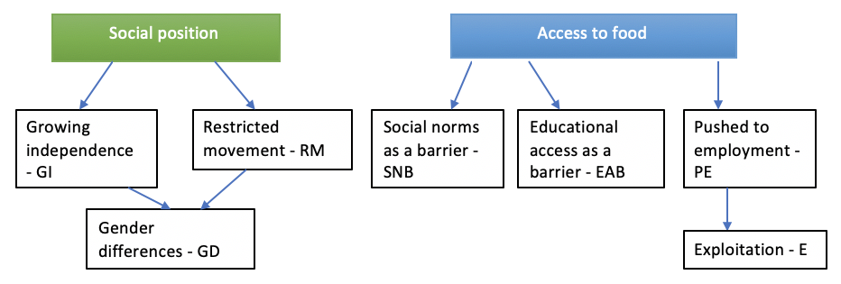

Coding in a Word document
KII – Research topic: adolescent health
Location: Fara Village in Bagara, Somalia
Participant: Fara village chief (FC)
Notes:
So what can coding actually look like?
This example if from qualitative research looking at issues related to adolescent health in Somalia.
In the example there are 5 codes here (say them) and 2 subcodes. They fall under two buckets.
This is how we would code using basic word processing software (e.g. Microsoft Word) or on paper:
If all your data are in Word or a similar word processing software (e.g. typed transcripts), you can place all the text in a table with a column to one side.
As you read through the text, type the relevant codes next to each piece of data relevant to that code in the column to the side.
SNB example from para 1
If you do not have too many codes, it can be useful to use different colours for each code, to help you to visually process the different emerging themes and their frequency. Even highlight the text that colour, will show you shortly.
You can also do this straight onto handwritten notes, by drawing a margin for you to write the codes in.
Note that some bits of text can have multiple codes attached to them.

Slide 7
Step 3: Generating themes
Overarching theme
Social position influences access to healthy foods for adolescents in rural Somalia
Notes:
If you remember the adolescent health research example from yesterday where we had codes around barriers to accessing healthy foods and growing independence of adolescents and so on.
One overarching theme to emerge from this research was as follows ‘Social position influences access to healthy foods for adolescents in rural Somalia’.
This theme reflects a pattern in the data, it groups a number of the codes, and it links back to one of the primary research questions which was around social determinants of adolescent health.
You can see how it is expressed in a longer phrase or sentence than those short codes we saw yesterday.

Slide 8
Step 3: Generating themes
CODES
Basic analytic units.
You can think of them as labels (words or short phrases) given to a piece of text about a particular topic.
Tools for organising your data.
The overarching ideas – the pattern or relationships across the data set.
Emerge when we look over our codes and see how they combine to answer our research questions.
Tend to be broader and more inclusive than codes (often combining several codes into one) and expressed in longer phrases or sentences.
Involve analysis and interpretation, rather than just using the interview questions.
THEMES
Notes:
Coming back to the final bullet point, themes also go one step further than codes, as they require more analysis and interpretation
Don’t use the individual interview questions as themes, a deeper level of analysis is required
So if we think to our example theme – ‘social position influences access to healthy foods for adolescents in rural Somalia’ that goes that step further with analysis.
Any qus?
We will give you some more examples, but we will first ask you to generate some ideas.

Slide 9
Generating themes
Look back at your data and codebook from cholera RQA.
What are some overarching themes?
What are the major issues facing survivors/caregivers? (illness narrative, careseeking & treatment, post discharge, community perceptions, CATI, aftermath)
REMEMBER, themes
The overarching ideas – the pattern or relationships across the data set.
Emerge when we look over our codes and see how they combine to answer our research/assessment questions.
Tend to be broader and more inclusive than codes and expressed in longer phrases or sentences.
Involve analysis and interpretation, rather than just using the interview questions.
Notes:
What we would like you to do is to look back at your data and your codebook and start suggesting what might be some overarching themes.
Without the full data set and all the codes, this is not easy as there are not so many codes to combine, but it is just to get you thinking.
Remember that themes…..
And each theme needs one central idea
Take 5 minutes to think of some themes and we will ask you to share.

Slide 10
Tips for generating themes
Generating themes is the creative part of analysis!
The outcome of this step is a list of themes and maybe sub-themes, with all the data coded against them.
Some of the individual codes may themselves become main themes (but not necessarily), some may become sub-themes.
Some codes might not belong anywhere - keep these together and revisit them later.
Some additional themes may continue to emerge as you group the data.
Notes:
We will finish the content of this session with some tips once again.
Generating themes is the creative part of analysis! This is the moment where you can play around with the coded data and really link it back to your original questions, and the purpose of your assessment. You need to ask yourselves what story does your data tell.
If significant enough, such a strong link to your assessment questions, lots of data.
Diagrams might be helpful to show how themes connect with eachother.
As with coding, this is likely to be an iterative process.
Any questions?

Slide 11
Practical exercise
Generating themes from your (inductively) coded cholera RQA data (can use either Word or Excel)
Notes:
Lets keep it a bit more simple.

Slide 12
Generating themes
Examples of themes to emerge
TBD
TBD
TBD
TBD
TBD
Notes:
These are some themes that emerged for us when we looked across the codes and started to find patterns that were relevant to the topic and that started answering the assessment questions.
As this was a programmatic assessment, we wanted themes that could point us in the right direction programmatically.
Read themes
You see how these are broader and more inclusive than codes and expressed in longer phrases or sentences. That have an extra level of interpretation
Any reflections or qus?

Slide 13
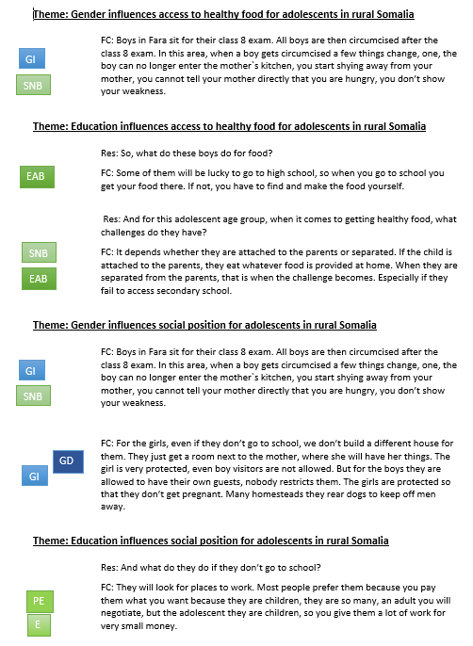
Using Word to group coded data under themes
Notes:
After you have generated your themes, the next step is grouping the coded data under each theme.
This is where we show the connection between the data and the theme through the process of grouping the coded data
This can be done in Word, Excel or qual analysis software.
In Word
Write each theme as a heading in a new Word document.
Paste relevant pieces of data under the relevant theme heading.
Once you have done this, you will have all the data relevant to a theme in one place and can look back over it to draw conclusions from the available data.
Note that this method can become unwieldy if you have a lot of data. It is best for smaller data-sets that need to be analysed quickly.
In low tech settings this can also be done on paper, by literally cutting out relevant sections of text and placing them in theme piles – if you are doing participatory data analysis or working with a team this can be a nice way to do it
Any qus?

Slide 14
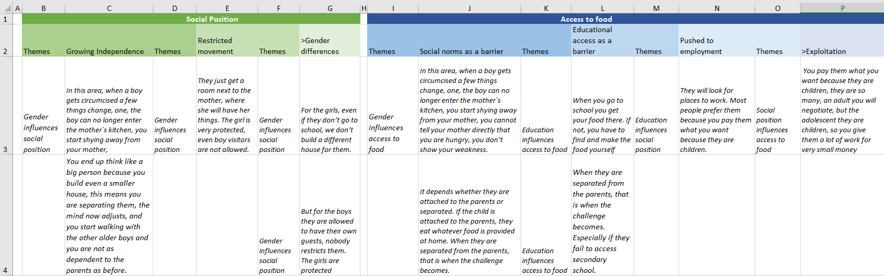
Using Excel to group coded data under themes
Notes:
Identifying and grouping themes using basic number processing software (e.g. Microsoft Excel)
If you have done your coding using Excel, you can add another blank column alongside each ‘code’ column, with the heading ‘Themes’.
As you look down the column where you have grouped data relevant to a code, you will see themes emerging. Label these themes in the new blank column.
This will help you to understand the different themes that have emerged relevant to a given topic, and their frequency.
Lots of experience in the room. Has anybody does this differently on Excel?

Slide 15
Reviewing your themes
Ask yourselves:
Do the themes link with the topic/idea being explored?
Does the data support the themes?
Is there sufficient data to make this a theme?
Is the theme too broad or too narrow to be programmatically useful?
If themes overlap, are they separate themes?
Am I missing any themes? Does any of the coded data not fit anywhere?
Notes:
Moving on, so part of generating your themes is reviewing them, whether by yourself or preferably with a colleague. There are a number of questions you can ask to scrutinise your themes.
There is no hard and fast rule for how much data is enough here.
Informal theme quite broad, can use a subtheme to make more operational.
If we had a theme around long distance to travel to school this may have too much overlap with sexual assault leading to school drop out, so it can be collapsed into it.

