Slide 1
Deductive Qualitative Analysis
Day 3
July 11, 2024

Slide 2
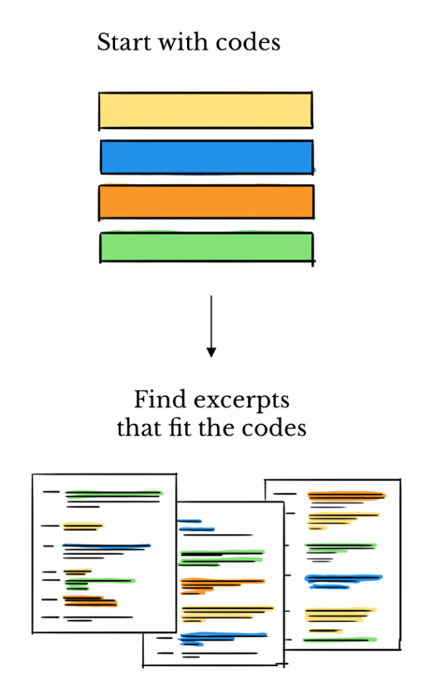
Deductive Analysis
When to use a deductive approach:
When you already have an idea of the responses/topics
Helpful with a larger coding team
When time is limited/need to code quickly
Limitations: not ideal for exploratory analysis

Slide 3
Examples of using deductive approach:
Hand Hygiene in Schools in 4 Countries
Locations: Guatemala, El Salvador, Belize, and Kenya
Four Coding Teams: Atlanta USA, Houston USA, Kenya, Guatemala
Approach: Deductive
A priori codebook with clear definitions made it possible to look across settings to see what challenges are experienced across contexts, which are context specific

Slide 4
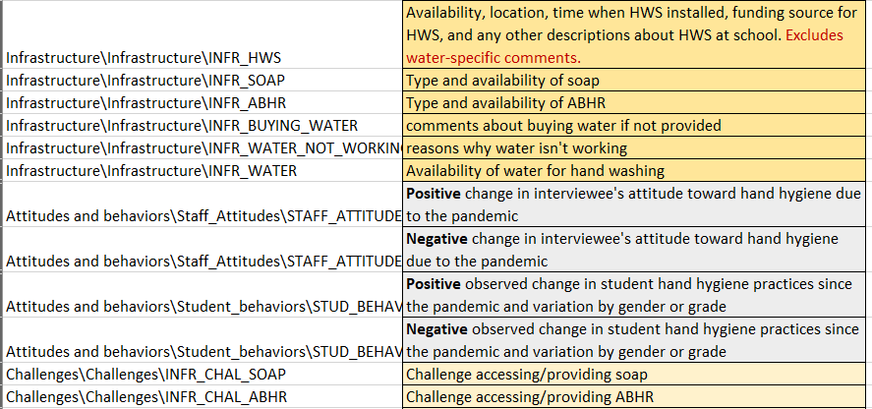
Using a pre-established codebook: example
General structure: Category / Code / Subcode

Slide 5
Using a pre-established codebook: example
Category/Topic
General structure: Category / Code / Subcode

Slide 6
Using a pre-established codebook: example
General structure: Category / Code / Subcode
Main Code

Slide 7
Using a pre-established codebook: example
Sub-Code
General structure: Category / Code / Subcode

Slide 8
Using a pre-established codebook: example
General structure: Category / Code / Subcode
DEFINE YOUR CODES!

Slide 9
Deductive Coding Process
Review the codebook, discuss with team
Read-through of interview notes/transcript
Select and code the data to the most specific level you can
Share with teammate for full review of codes
Meet to review/resolve differences in codes

Slide 10
Deductive Coding: FAQs
What if multiple codes apply to the same segment of text?
Double coding is okay! If the same 2 codes are being applied repeatedly, reconsider definitions.
How much text should I code as a “segment”?
Include the question, and any relevant text from the answer, to the sentence/phrase level (no need to include unlreated text that follows
What if something comes up in the data that doesn’t have an applicable code but seems important?
Code as “miscellaneous/other” and then revisit with the team to create a new code if needed

Slide 11
Thank you!

Slide 12
Using a pre-established codebook
This is ONE example of a coding scheme, can be organized based on your needs
[FEEDBACK]
Type - questions, observations, suggestions?
Category - questions about response processes, about disease, about vaccines
Code - questions about disease symptoms, questions about vaccine safety

Slide 13
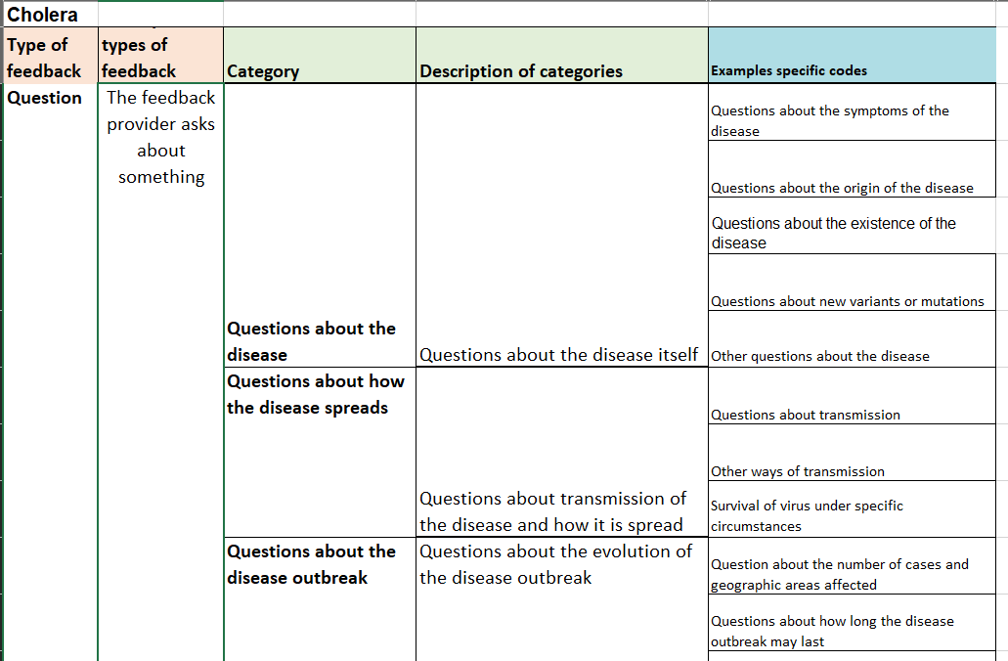
Coding feedback data

Slide 14
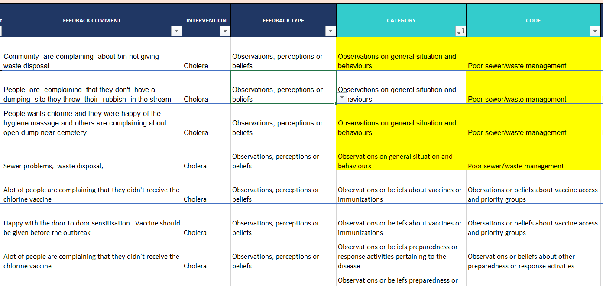
Coding community feedback data

